Slide 1
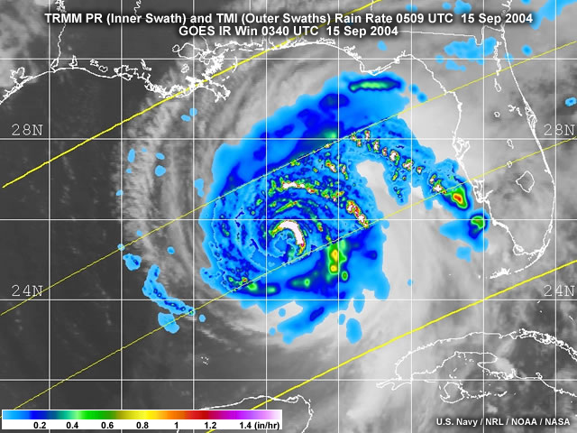
Tropical Cyclones in a Changing Climate
Julio Bacmeister, Cécile Hannay, Rich Neale, John Truesdale AMP/CGD
Nan Rosenbloom, Susan Bates CCR/CGD
Peter Lawrence TSS/CGD
Justin Small OS/CGD
Colin Zarzycki ASP
Kevin Reed SUNY Stonybrook
Michael Wehner DOE LBNL
Thanks to Warren Washington, Jerry Meehl
NCAR Networking and Discovery Day, April 17 2015
Notes:
Hurricane Ivan – Cat5

Slide 2
Climate models at high-resolution (Δx<50km) begin to resolve tropical cyclones
Zhao, M., I. M. Held, S.-J. Lin, and G. A. Vecchi, 2009: Simulations of global hurricane climatology, interannual variability, and response to global warming using a 50-km resolution GCM. J. Climate, 22, 6653–6678

Slide 3
CAM5 ~25km resolution 2005 08/01-08/19
Precipitation

Slide 4
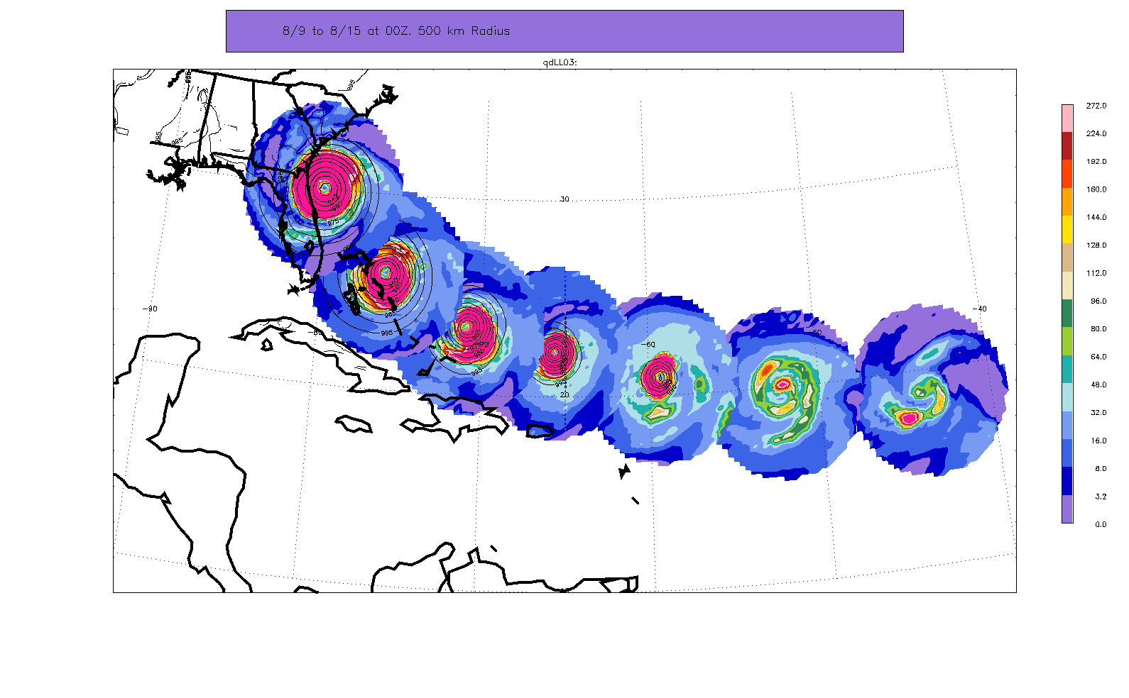
Intense Atlantic hurricanes 25km (0.25º) CAM5
Precipitation within 500 km of storm center
Aug 15
Aug 14
Aug 13
Aug 12
Aug 11
Aug 10
Aug 9
Forms spontaneously in free-running CAM5 climate model run
Minimum pressure ~910 hPa and maximum winds ~140 mph
Realistic “Cape Verde” storm (note dry eye)
Notes:
Individual storms look realistic,
now about stats ….

Slide 5
Overview
We will examine prescribed SST (sea-surface temperature) runs at 0.25º (~25 km) resolution using CAM5.3
Present day: Observed monthly mean SSTs 1979-2012. Historical time varying CO2 and other GHG, anthropogenic aerosol emissions, … (3 ensemble members)
Future “time-slice”: Bias corrected monthly mean SSTs 2070-2100. Other forcings from RCP8.5 scenario (3 ensemble members completed – 2 analyzed)
No retuning of CAM5.3 physics for 25km resolution!!

Slide 6
Physical parameterizations in CAM
Model | CAM3 CCSM3 | CAM4 CCSM4 | CAM5 (CAM5.1) CESM1.0 (CESM1.0.3) | CAM5.3 CESM1.1
Release | Jun 2004 | Apr 2010 | Jun 2010 (June 2011) | June 2013
PBL | Holtslag-Boville (1993) | Bretherton et al (2009) | Bretherton et al (2009) | Bretherton et al (2009)
Orographic form drag |  |  | Richter et al. (2010) | Richter et al. (2010)
Shallow Convection | Hack (1994) | Hack (1994) | Park et al. (2009) | Park et al. (2009)
Deep Convection | Zhang-McFarlane (1995) | Neale et al. (2008) | Neale et al. (2008) | Neale et al. (2008)
Microphysics | Rasch-Kristjansson (1998) | Rasch-Kristjansson (1998) | Morrison-Gettelman (2008) | Morrison-Gettelman (2008)
Macrophysics | Rasch-Kristjansson (1998) | Rasch-Kristjansson (1998) | Park et al. (2011) | Park et al. (2011)
Radiation | Collins et al. (2001) | Collins et al. (2001) | Iacono et al. (2008) | Iacono et al. (2008)
Aerosols | Bulk Aerosol Model | Bulk Aerosol Model BAM | Modal Aerosol Model Ghan et al. (2011) | Modal Aerosol Model Ghan et al. (2011)
Dynamics | Spectral | Finite Volume | Finite Volume | Spectral element
= New parameterization/dynamics

Slide 7
Physical parameterizations in CAM
Model | CAM3 CCSM3 | CAM4 CCSM4 | CAM5 (CAM5.1) CESM1.0 (CESM1.0.3) | CAM5.3 CESM1.1
Release | Jun 2004 | Apr 2010 | Jun 2010 (June 2011) | June 2013
PBL | Holtslag-Boville (1993) | Bretherton et al (2009) | Bretherton et al (2009) | Bretherton et al (2009)
Orographic form drag |  |  | Richter et al. (2010) | Richter et al. (2010)
Shallow Convection | Hack (1994) | Hack (1994) | Park et al. (2009) | Park et al. (2009)
Deep Convection | Zhang-McFarlane (1995) | Neale et al. (2008) | Neale et al. (2008) | Neale et al. (2008)
Microphysics | Rasch-Kristjansson (1998) | Rasch-Kristjansson (1998) | Morrison-Gettelman (2008) | Morrison-Gettelman (2008)
Macrophysics | Rasch-Kristjansson (1998) | Rasch-Kristjansson (1998) | Park et al. (2011) | Park et al. (2011)
Radiation | Collins et al. (2001) | Collins et al. (2001) | Iacono et al. (2008) | Iacono et al. (2008)
Aerosols | Bulk Aerosol Model | Bulk Aerosol Model BAM | Modal Aerosol Model Ghan et al. (2011) | Modal Aerosol Model Ghan et al. (2011)
Dynamics | Spectral | Finite Volume | Finite Volume | Spectral element
= New parameterization/dynamics

Slide 8
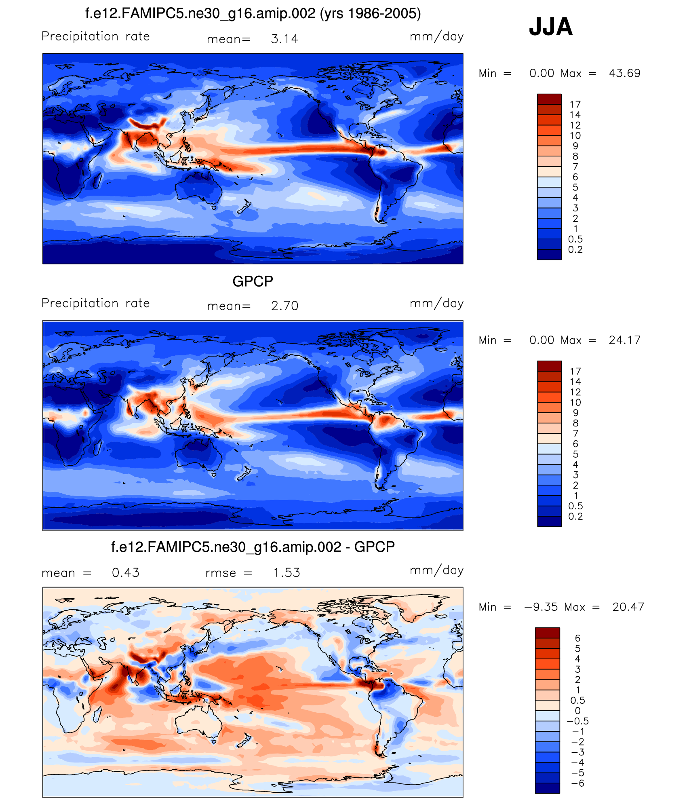
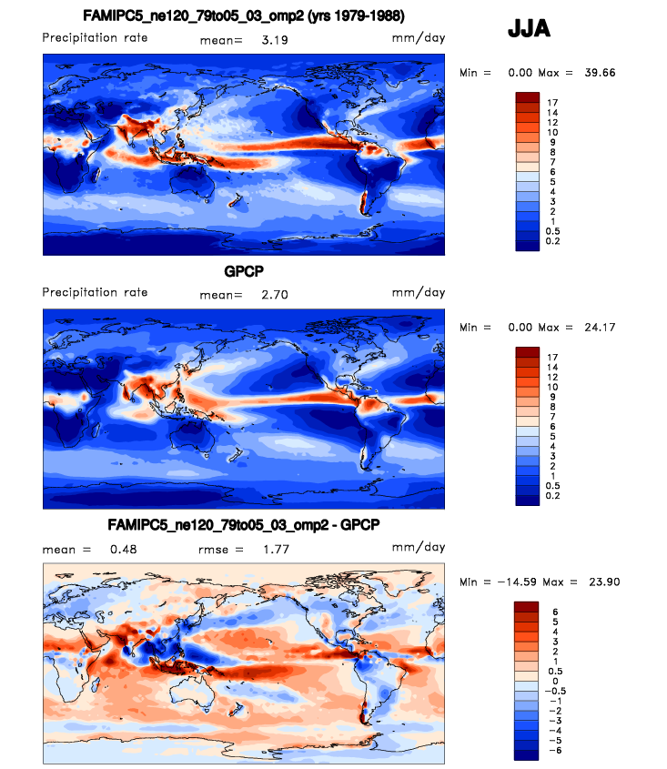
JJA Seasonal-mean precipitation (1980-2005)
ne30 – 100 km
ne120 – 25 km
DJF ¼ degree
JJA ¼ degree
DJF GPCP
JJA GPCP

Slide 9
“Track densities”
Average number of hours per year that a storm is present in a 2ºx2º gridbox
X
X

Slide 10
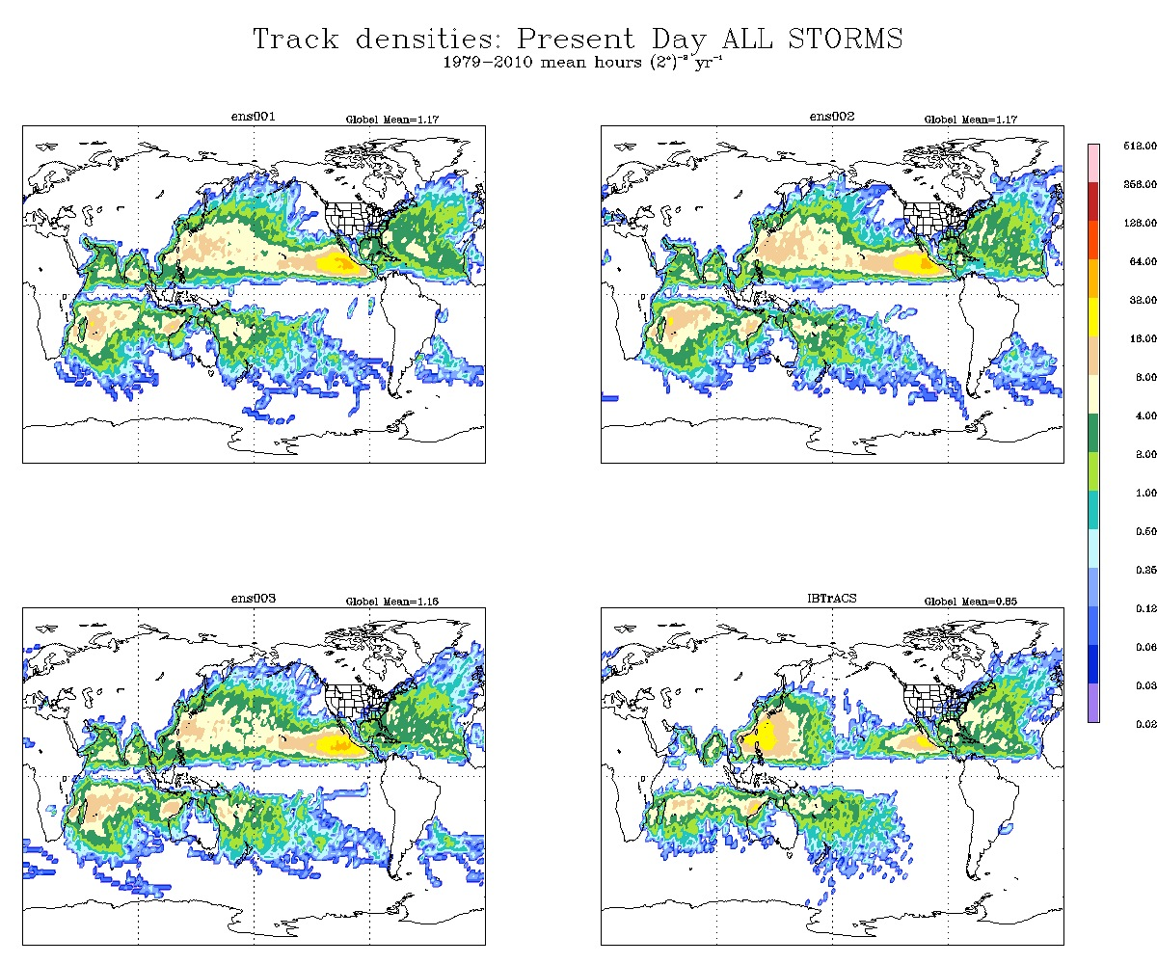

Slide 11
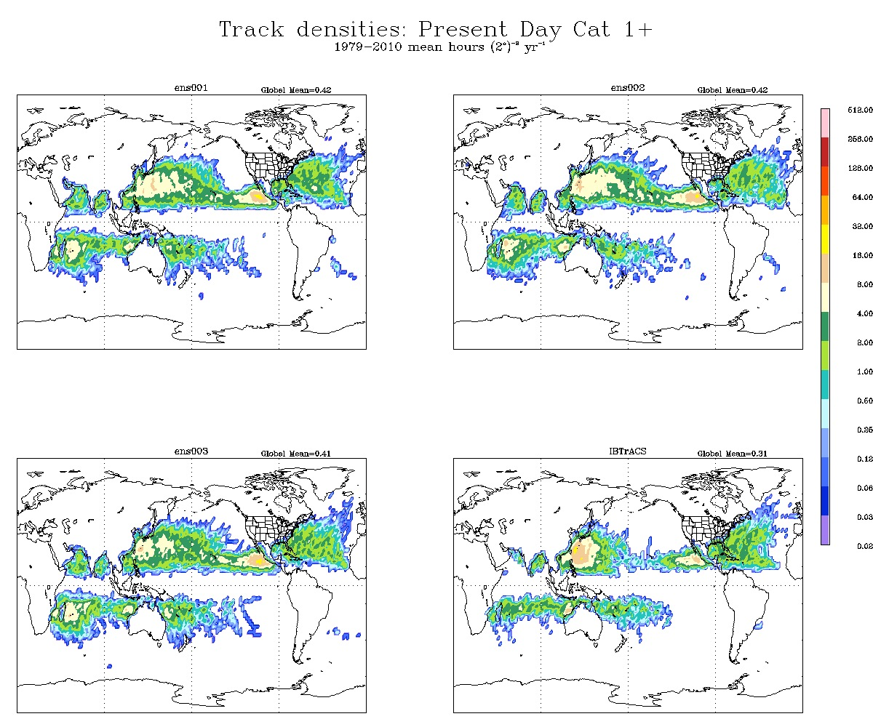

Slide 12
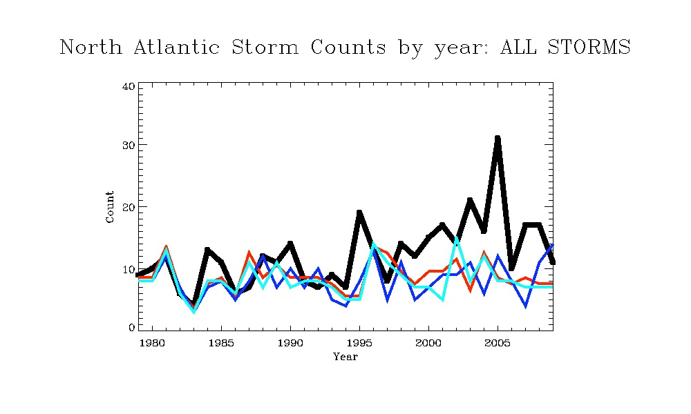

Slide 13
Strong El Niños

Slide 14
To the Future …
Future “time-slices”: Bias corrected monthly mean SSTs 2070-2100
Why not just stick to coupled atmosphere/ocean runs?

Slide 15
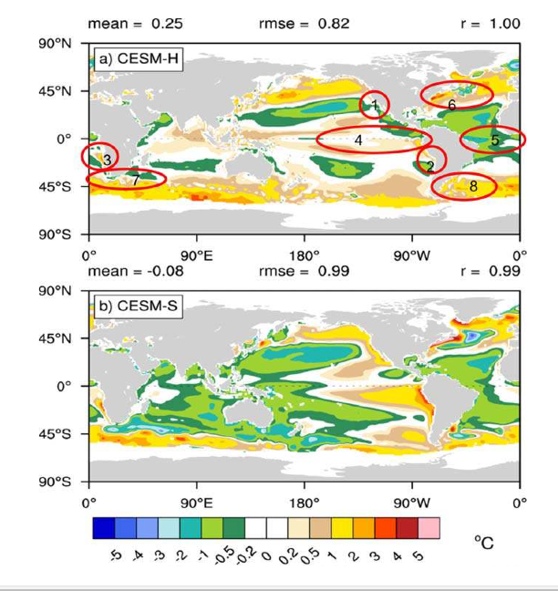
25km atmos
0.1º ocean
100km atmos
1º ocean
Small, R. J., et al. (2014), A new synoptic scale resolving global climate simulation using the Community Earth System Model, J. Adv. Model. Earth Syst., 6, 1065–1094, doi:10.1002/
2014MS000363.

Slide 16
To the Future …
Future “time-slices”: Bias corrected monthly mean SSTs 2070-2100

Slide 17
Bias corrected SSTs for “Time-Slice” runs
Mean CESM SST bias for each month = m at point (x,y) is calculated from a present day coupled simulation (years_{k}=1982-2001)
Unbiased SST’s for month m_{i} in any future year_{i} now estimated by
Where T_{CESM} is SST from a coupled 1x1 RCP scenario run.
Assumes bias is constant in time. Interannual variability is contributed by CESM run
Notes:
Maps of monthly mean SST bias are calculated from a CESM run 1982-2001

Slide 18
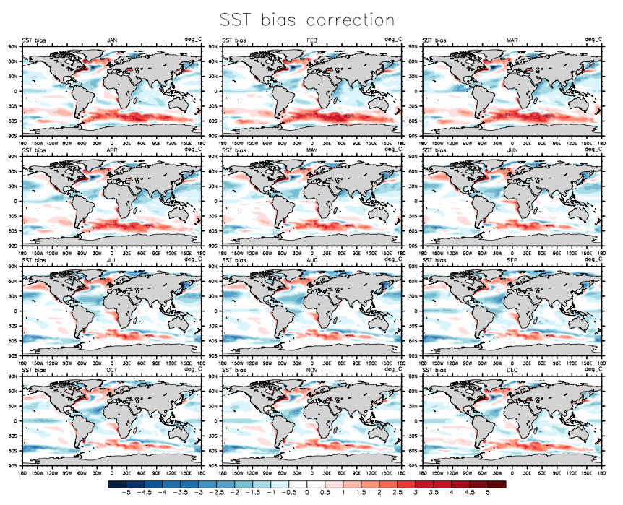
Monthly SST biases 1982-2001

Slide 19
Bias corrected SSTs for “Time-Slice” runs
Method can be tested by creating “alternate realities” i.e. alternate present day SSTs T_{PD(n)} constructed from present day CESM simulation+bias correction
PD(1)
Obs.
δ(1)
CESM(1)
The Past-Present (e.g. 1979-2015)
Notes:
Alternate present day SSTs can be generated by adding bias corrections to SSTs from CESM runs. Here PD(1) tries to illustrate schematically adding the bias calculated from a particular CESM SST back to the same SST. PD(n) [PD2 in subsequent plots] tries to illustrate addition of bias to a *different* CESM SST. Both are equally plausible alternate present day SSTs. We might expect PD1 to be “better”, but doesn’t always seem to be the case.

Slide 20
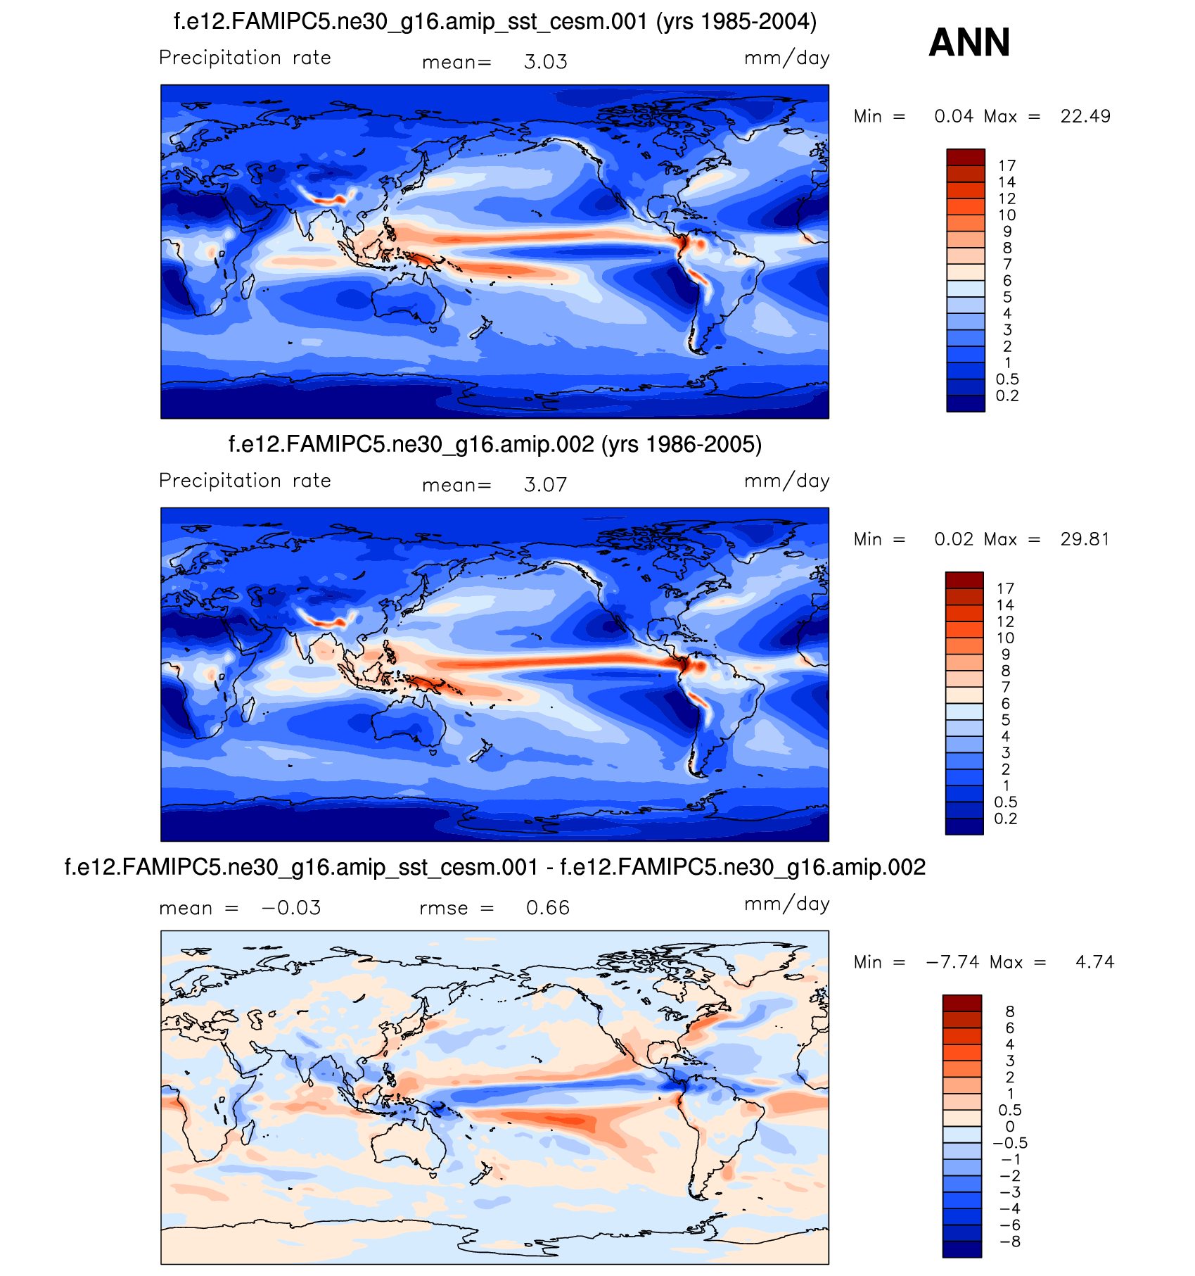
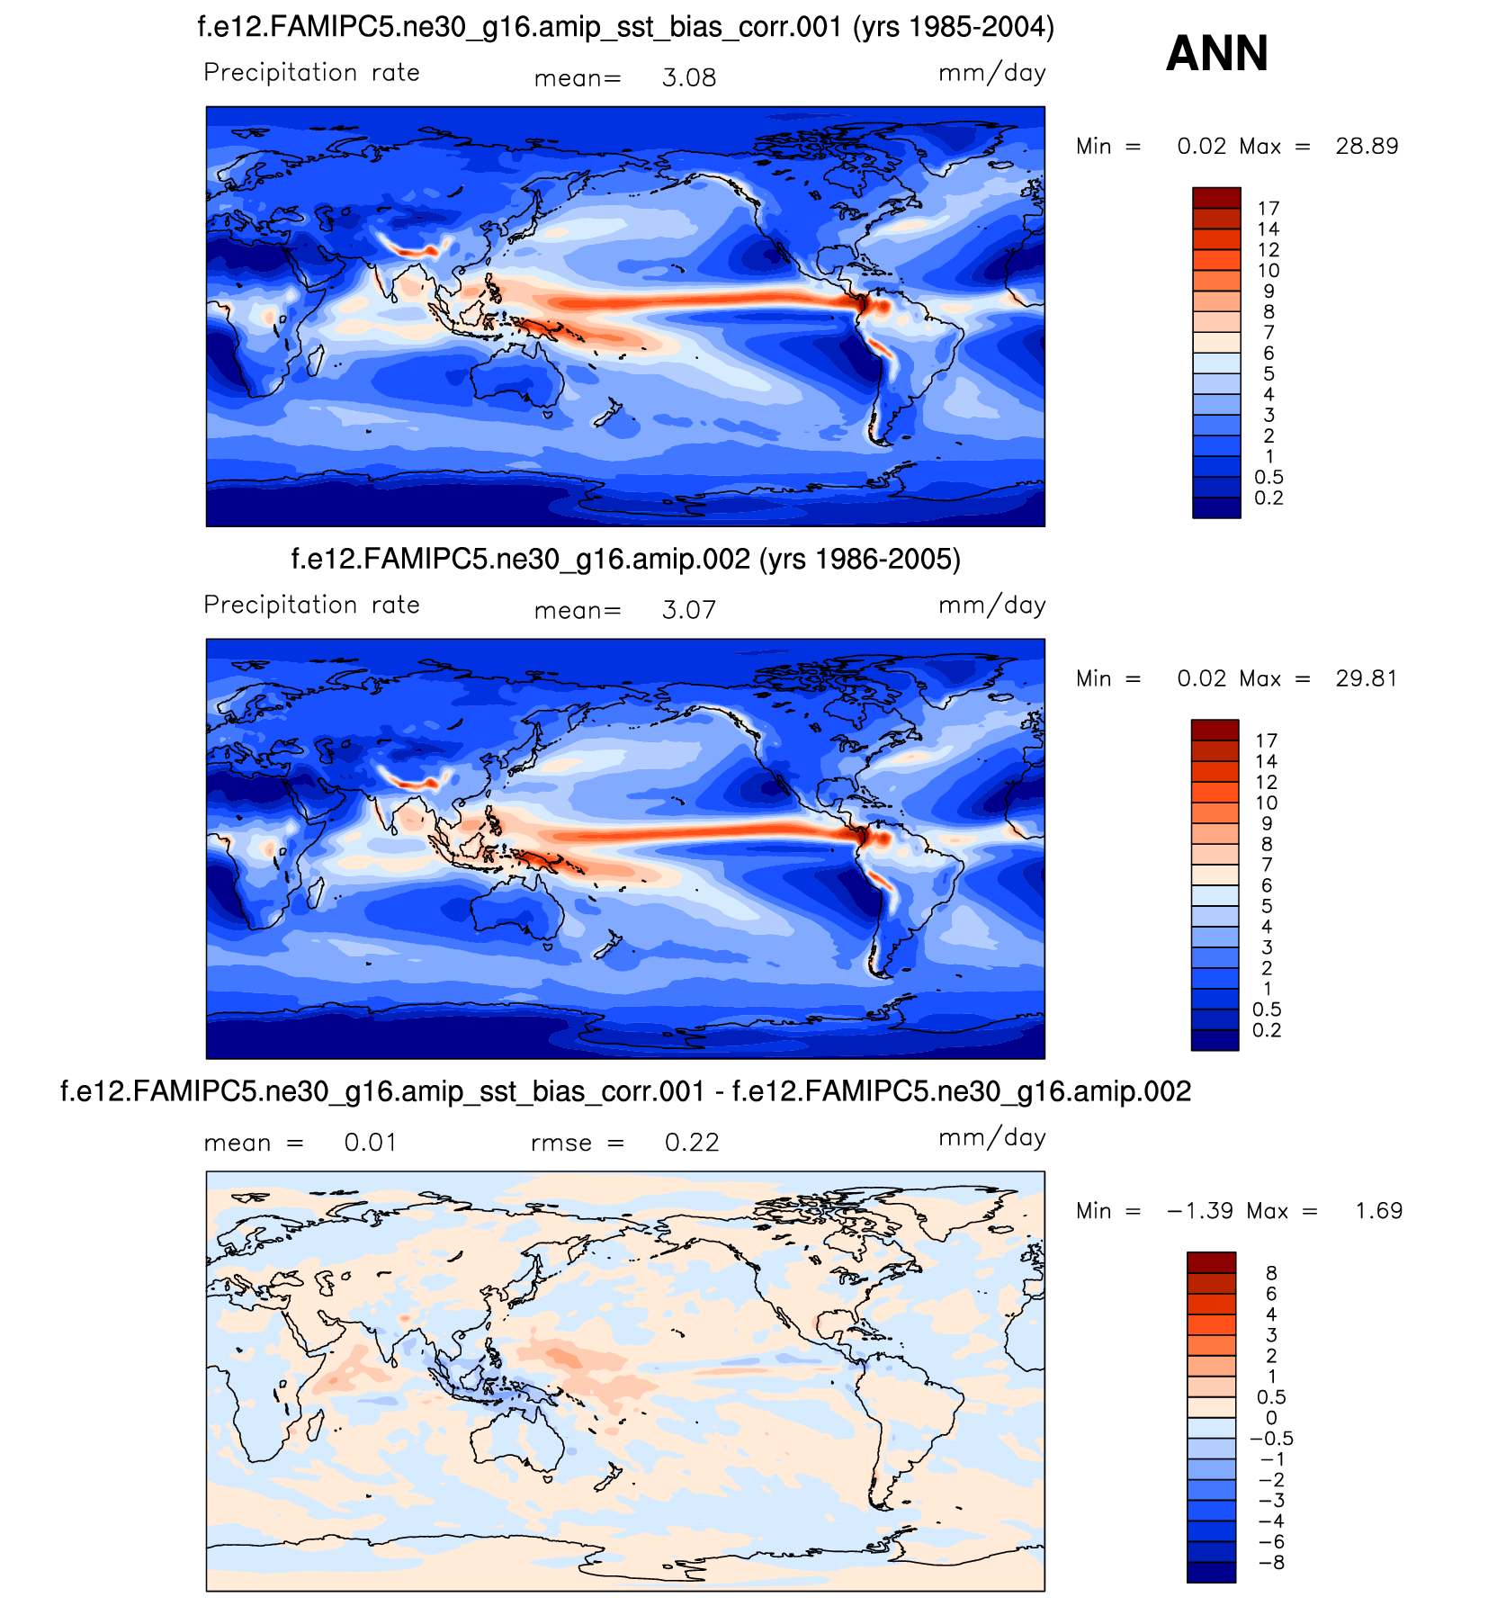
Mean JJA 1986-2005 precipitation (prescribed alternate SSTs) vs AMIP w/obs SSTs
From Cecile Hannay
Uncorrected CESM SSTs
Corrected CESM SSTs
Standard AMIP
Standard AMIP
diffs
diffs
Notes:
JJA precipitation (1986-2005) from AMIP runs forced with uncorrected CESM SSTs and PD1, and PD2. Note much smaller biases w/ resp GPCP for PD1 and PD2

Slide 21
Future SSTs and CO₂
CO2 Mixing Ratio
799 ppmv
361 ppmv

Slide 22
TC Track densities

Slide 23
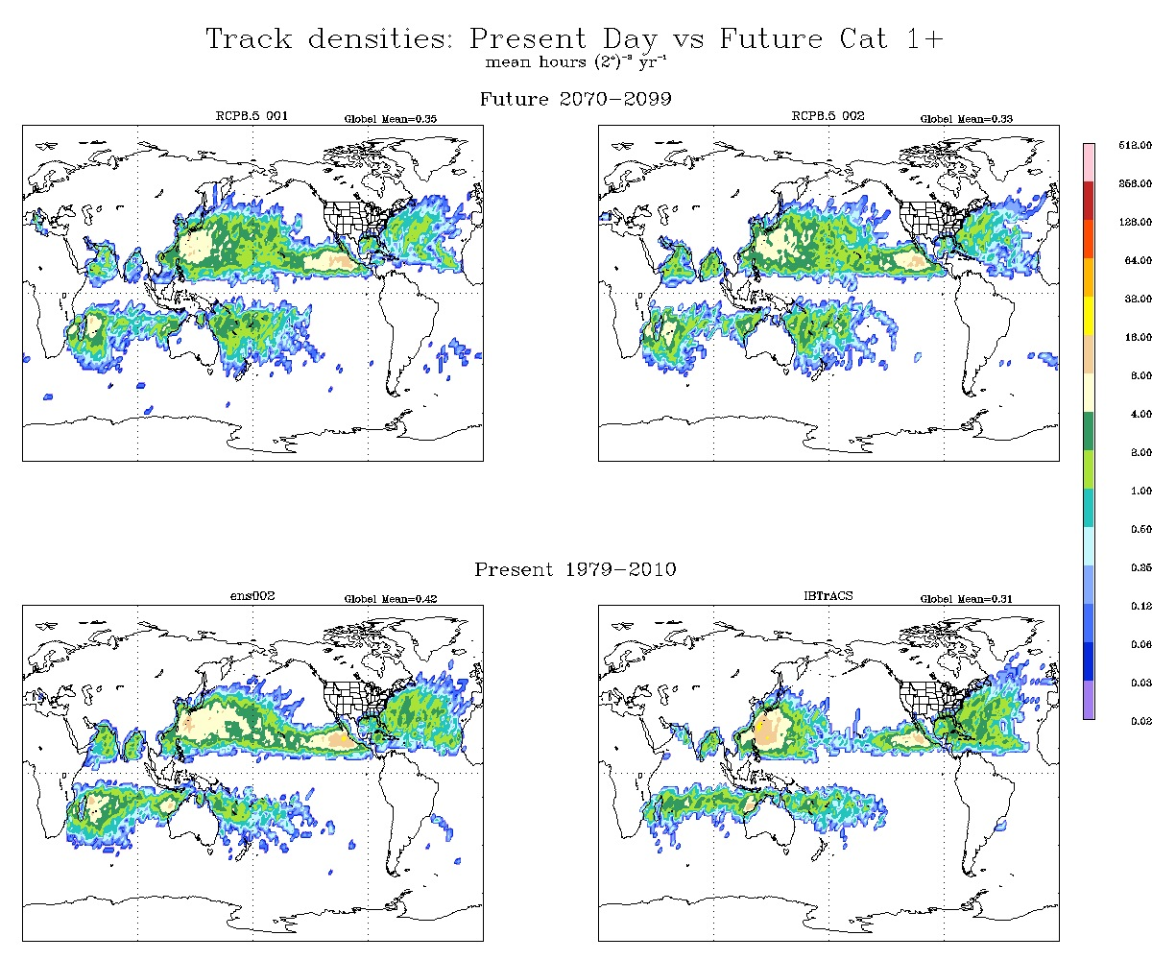

Slide 24
Nearly 2x projected decrease in N Atlantic!

Slide 26
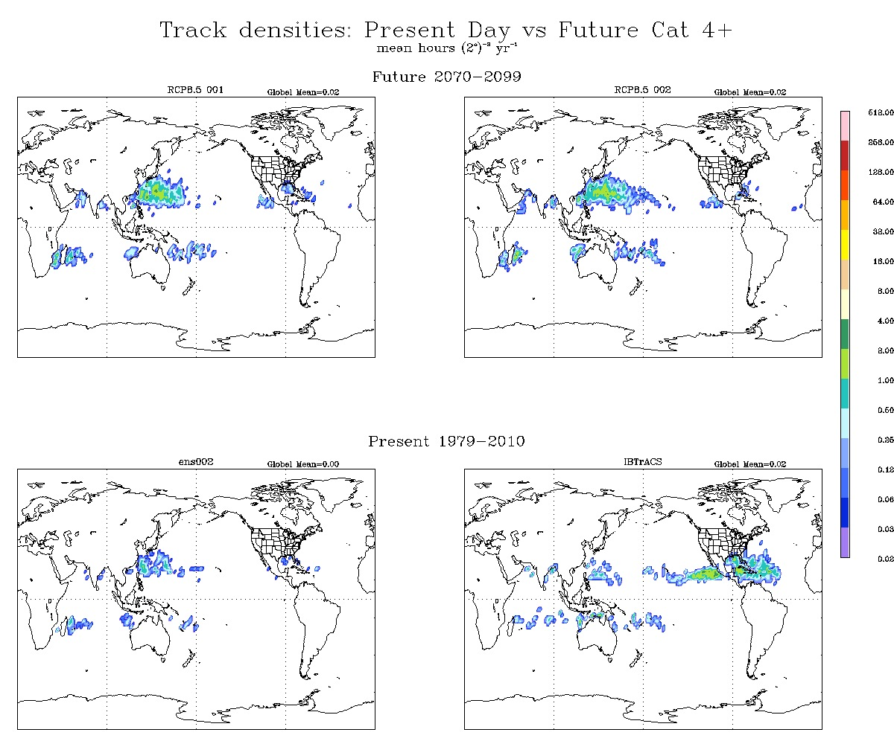

Slide 27
Storm Precipitation
Aug 15
Aug 14
Aug 13
Aug 12
Aug 11
Aug 10
Aug 9

Slide 28
Storm Precipitation
Aug 15
Aug 14
Aug 13
Aug 12
Aug 11
Aug 10
Aug 9
Simple definition - Instantaneous precipitation within 500 km of storm
Total storm precipitation: Sum of storm precipitation over space and time over life of an individual storm

Slide 29
Present day
Future

Slide 30
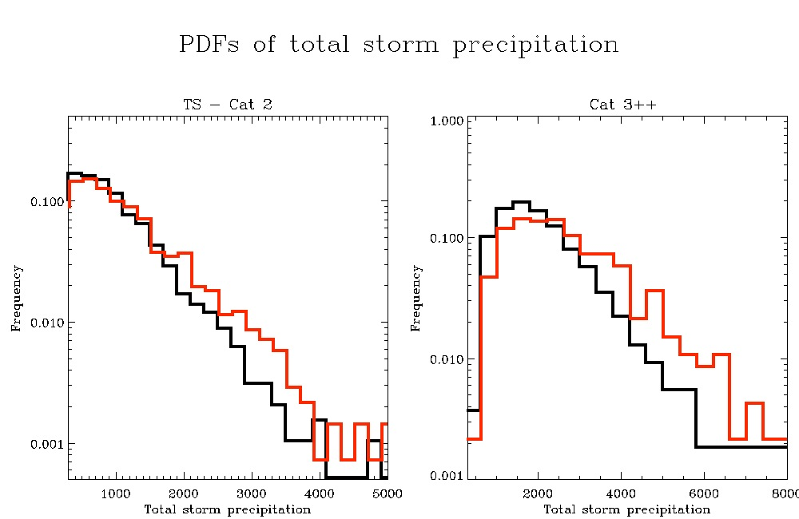

Slide 31
Summary
CAM5 projects fewer storms overall in 2070-2100 under RCP8.5. N Atlantic reduction is nearly 2x
Aerosols?
More Cat4+ storms are projected – especially in NW Pacific basin
Storms in all categories are projected to be rainier

