Slide 1
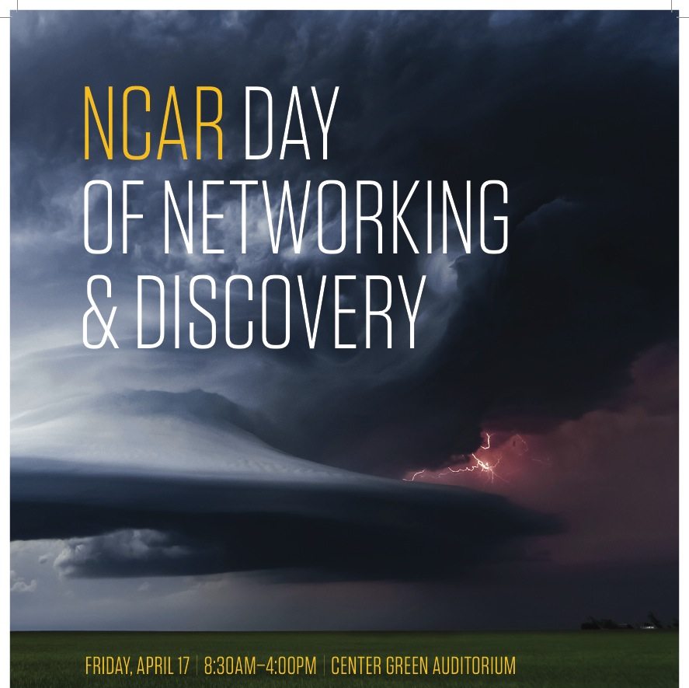

Slide 2
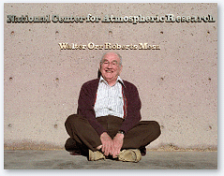
Scientific and Technical Excellence of NCAR
Only by being a center of scientific excellence and innovation can NCAR excel in its mission, including that of supporting, enhancing and extending the capabilities of the university and broader research communities
A world-leading research program is:
  Critical to developing NCAR’s major community instrumentation and computational facilities, as well as community models and data assimilation systems
  Basis for extensive collaboration with academia and ability to galvanize the community through a strategic focus on grand challenge problems
  Origin for NCAR’s large and successful visitor program
  Source of NCAR’s strong record of community leadership and ability to serve as a crossroad for the exchange of ideas
  Key to exceptional track record of educating and entraining talented and diverse students and early career professionals
Notes:
The university community will continue to depend on NCAR to be a center of scientific excellence and innovation. Its science is the foundation for all aspects of its collaborative research and community-based resources, as well as its visitor and postgraduate programs. Universities will also continue to look to NCAR to provide resources that complement and extend their own, to serve as a crossroad for the exchange of ideas, and to embrace a leadership role that galvanizes the community through a strategic focus on “grand challenge” scientific problems. World-class observational facilities, computational services and technology, and community models (all of which are at the core of NCAR) are not possible without a permanent scientific staff of the highest quality, as originally envisioned by Walter Orr Roberts. Moreover, NCAR will not be able to tackle the ambitious research agenda appropriate of a national center – an agenda that both supports and amplifies NSF and community goals – without a superlative scientific staff.

Slide 3


^{The NCAR Mission}
To understand the behavior of the atmosphere and related Earth and geospace systems
To support, enhance, and extend the capabilities of the university community and the broader scientific community, nationally and internationally
To foster the transfer of knowledge and technology for the betterment of life on Earth
An eminent research program is necessary in order for NCAR to accomplish this mission. Moreover, only through superlative research can NCAR meet emergent scientific challenges and possess the agility to adapt to the changing needs of the community.
NCAR Strategic Plan (2014)
Overview of NCAR
air • planet • people
Notes:
Presentation title in Verdana
Tagline in Baskerville, black

Slide 4

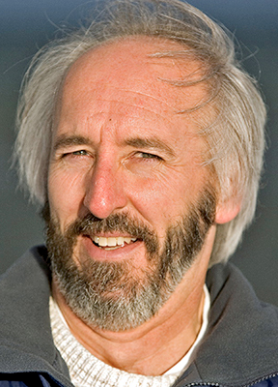
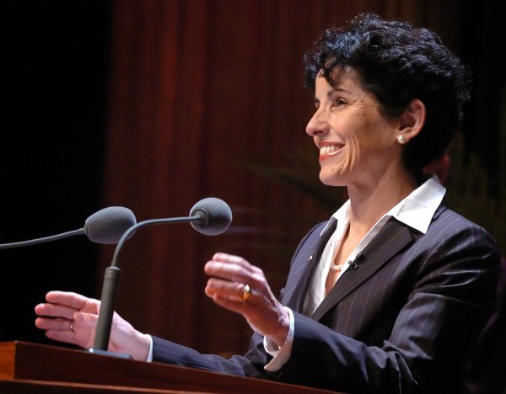
Dr. France Córdova
Director, NSF
Dr. Paul Shepson
Director, NSF/AGS

Slide 5
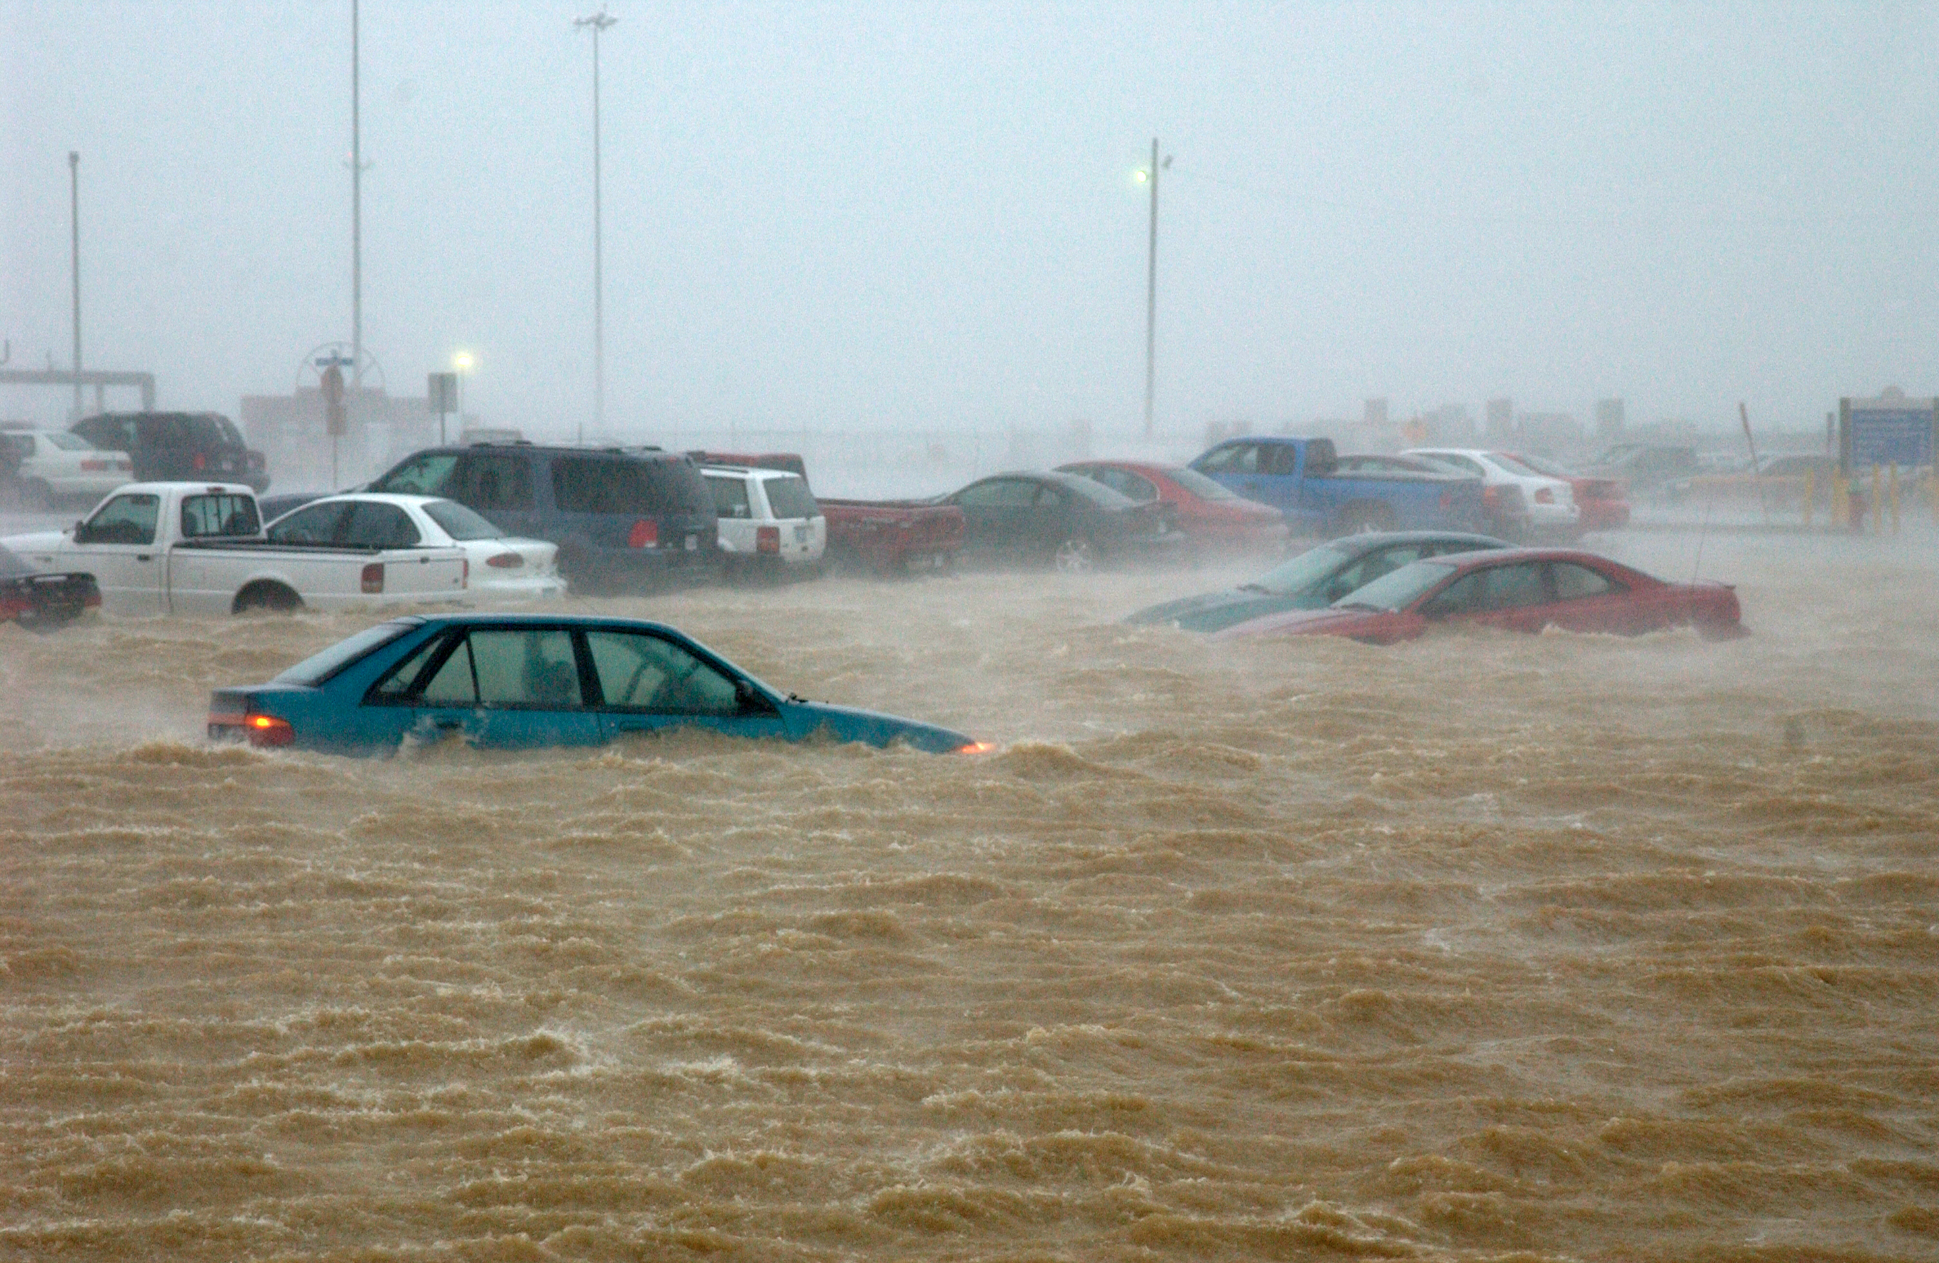
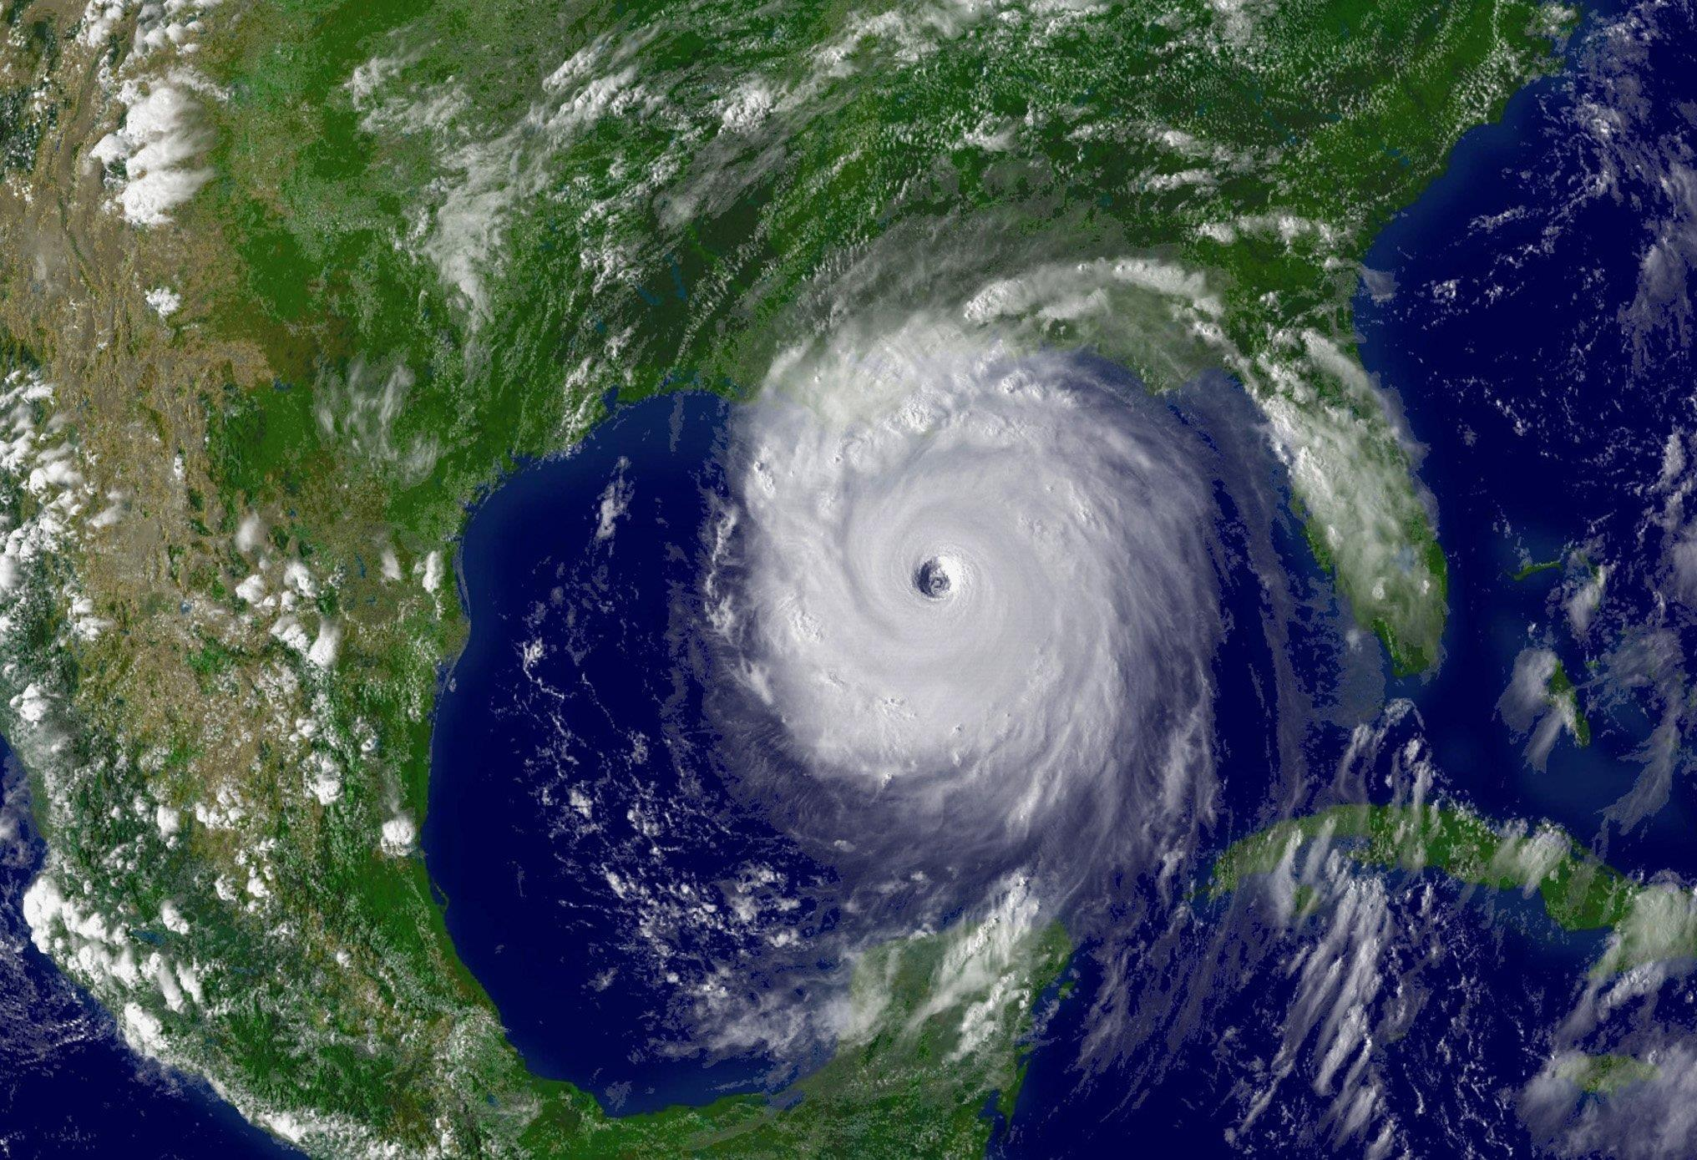
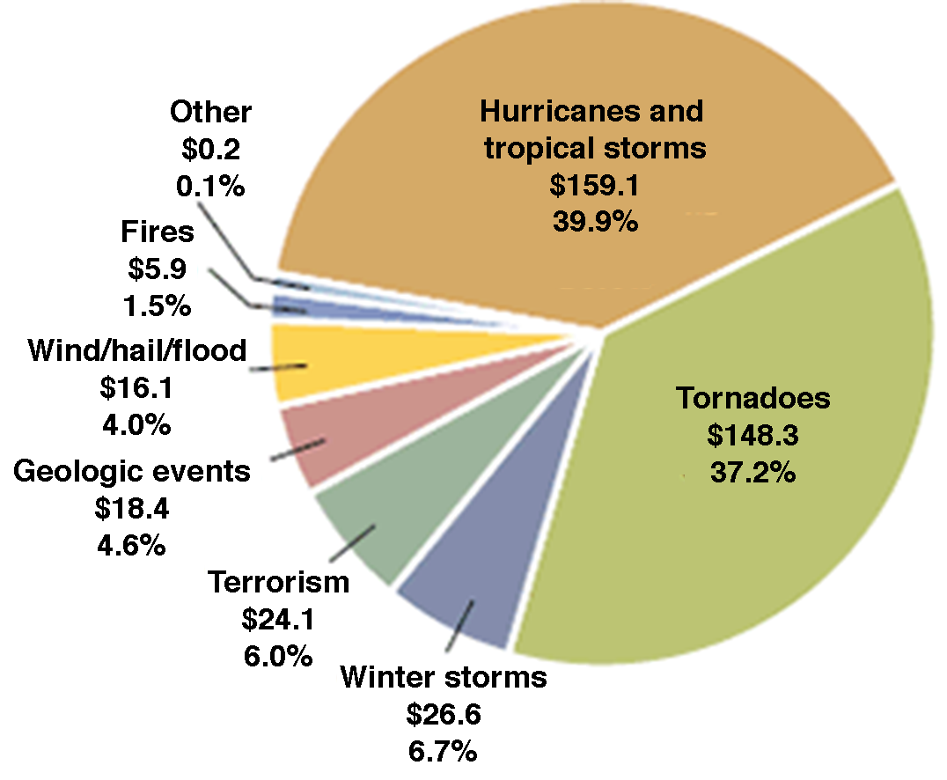
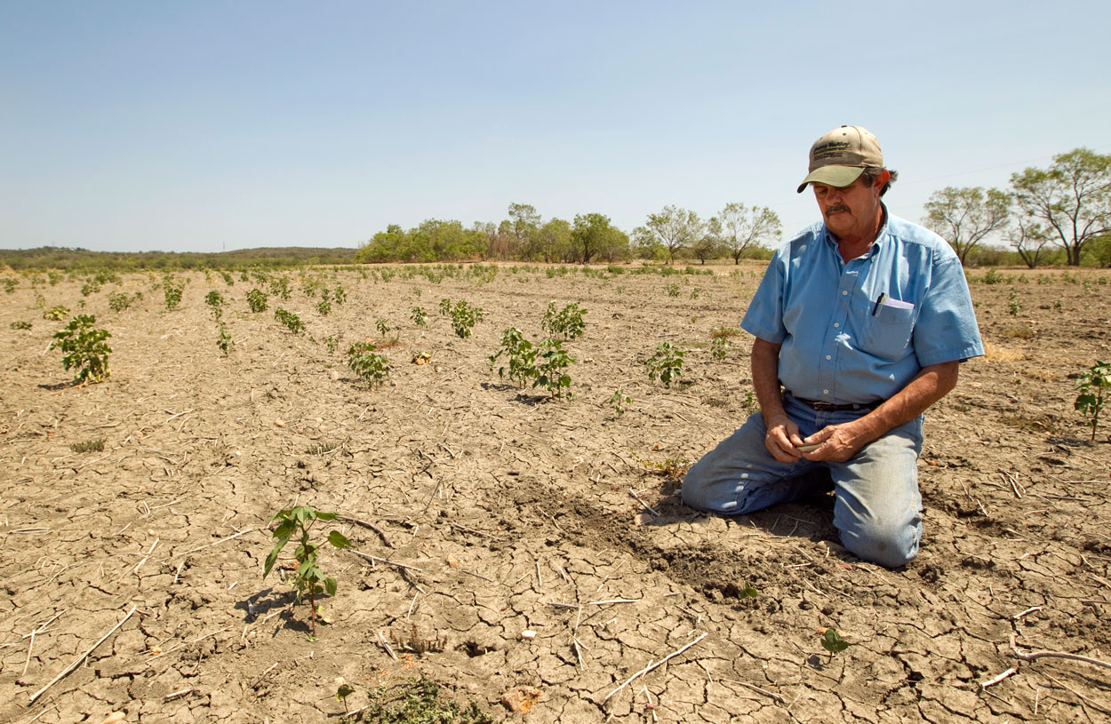
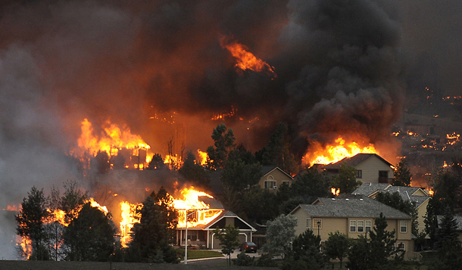

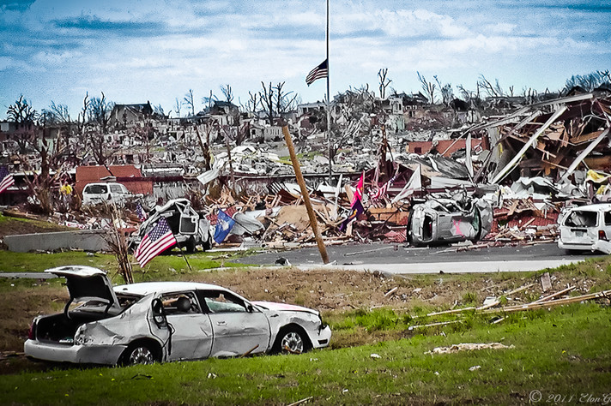
The Role of NCAR
Weather and Climate Related Hazards
Inflation-Adjusted US Insured Catastrophe Losses (1994-2013)
Total $398.7B
Munich Re

Slide 6
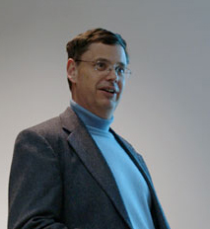

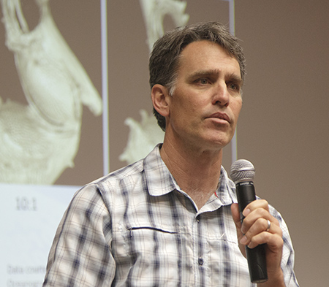


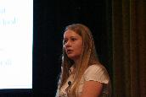












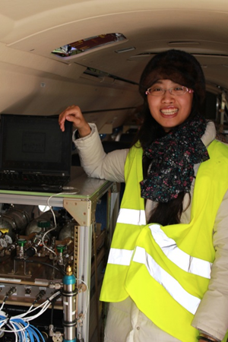
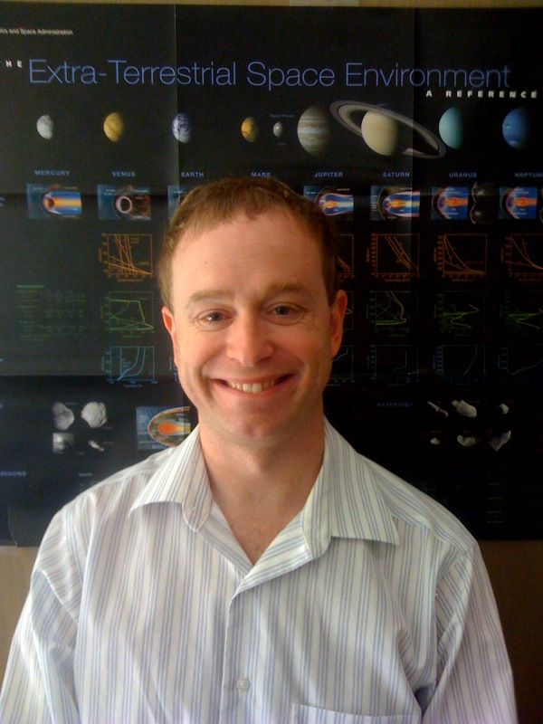

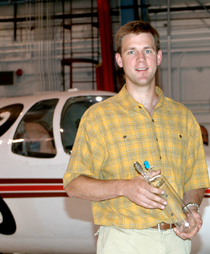





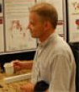



Our most valuable asset …

Slide 7
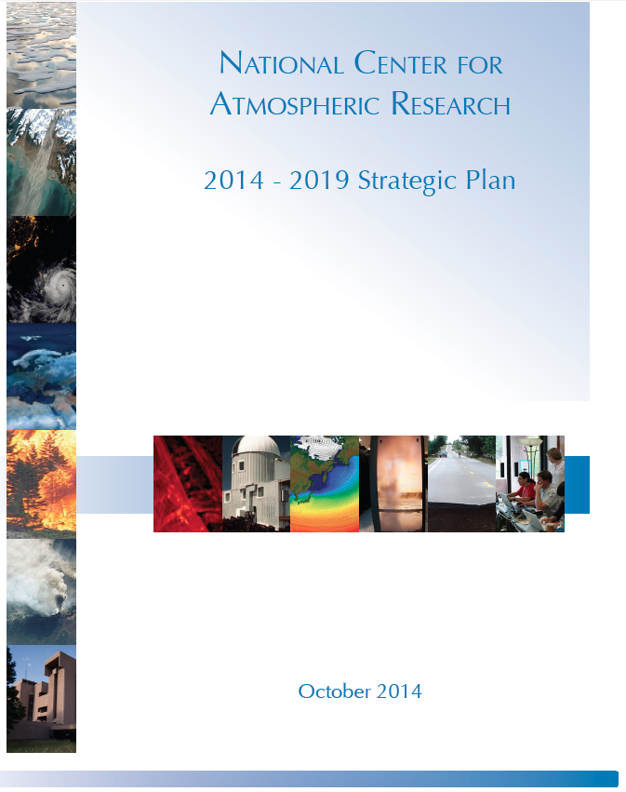

NCAR Strategic Plan
  Approved by NSF (October 2014)
  Strong alignment with Dynamic Earth: GEO Imperatives and Frontiers
  Understanding of and Resilience to Hazards and Extreme Events
  Water Cycle Research
  Next Generation Sun and Earth System Community Models
  State-of-the-Art Observational Facilities
  Computational Infrastructure and HPC
  Frameworks for Open and Easy Discovery and Access to Digital Assets
  Diversity, Education and Outreach
Notes:
e.g., ACD: these capabilities are especially relevant for addressing future challenges linked to air quality, climate change and ozone depletion on regional and global scales with regard to population growth and economic development

Slide 8
