Slide 1
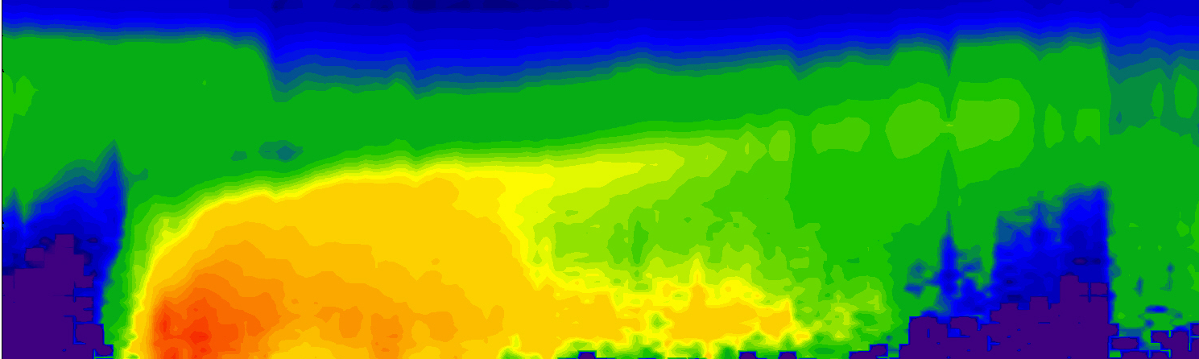


Unraveling the mysteries of
atmospheric nanoparticle formation
Jim Smith
NCAR Atmospheric Chemistry Observations & Modeling (ACOM) Laboratory
Aerosol Physics Research Group, Univ. of Eastern Finland @ Kuopio
April 17, 2015
NCAR Networking and Discover Day
Notes:
1

Slide 2






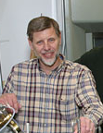
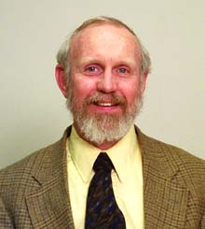

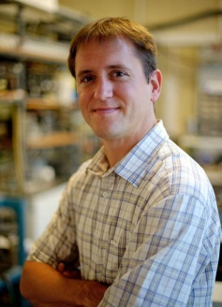



Acknowledgements: The New Particle Formation Team
Markku
Kulmala
U Helsinki
Ari
Laaksonen
Finn Met Inst
Annele
Virtanen
U E. Finland
Kelley
Barsanti
UC Riverside
Murray
Johnston
U Delaware
Chris Hogan
U Minn
Fred Eisele
NCAR
Pete McMurry
U Minn
Lea
Hildebrandt Ruiz
Paul Winkler
Jun Zhao
John Ortega
Mike Lawler
Funding Agencies:
National Science Foundation
Department of Energy
Finnish Academy & Saastamoinen Foundation

Slide 3
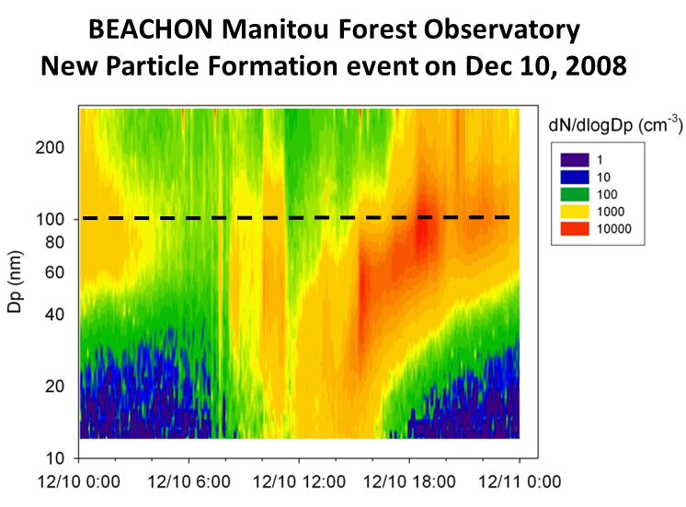
Why should we care about atmospheric nanoparticles?
Nanoparticles are the “building blocks” of atmospheric aerosols … their formation is observed around the world and their growth to larger sizes is important for cloud formation.
Nanoparticles may have health impacts because of their ability to translocate.
Nanoparticles are a unique state of matter that lie in the transition between molecular clusters (~1 nm) and bulk aerosol (>50 nm).
diameter that can activate into a cloud droplet at 0.2% supersaturation

Slide 4
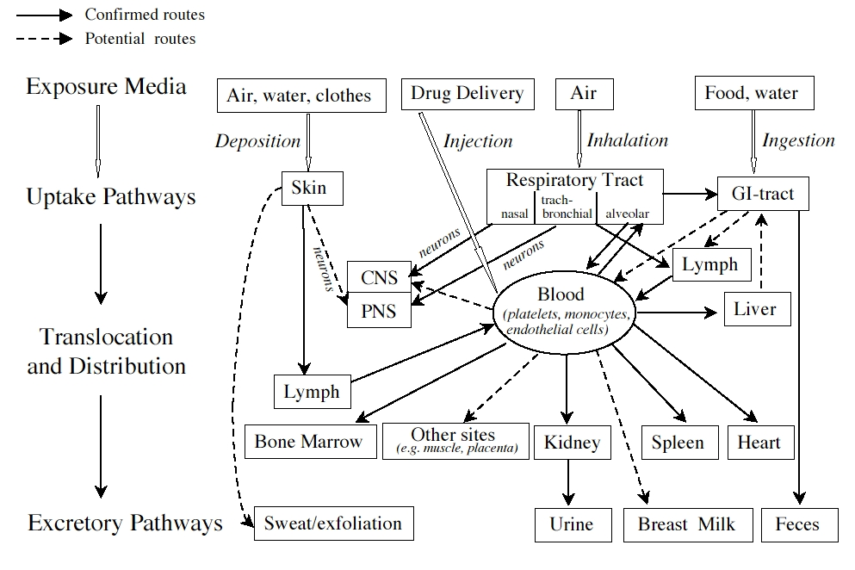
Why should we care about atmospheric nanoparticles?
Nanoparticles are the “building blocks” of atmospheric aerosols … their formation is observed around the world and their growth to larger sizes is important for cloud formation.
Nanoparticles may have health impacts because of their ability to translocate.
Nanoparticles are a unique state of matter that lie in the transition between molecular clusters (~1 nm) and bulk aerosol (>50 nm).
Oberdörster, 2005

Slide 5
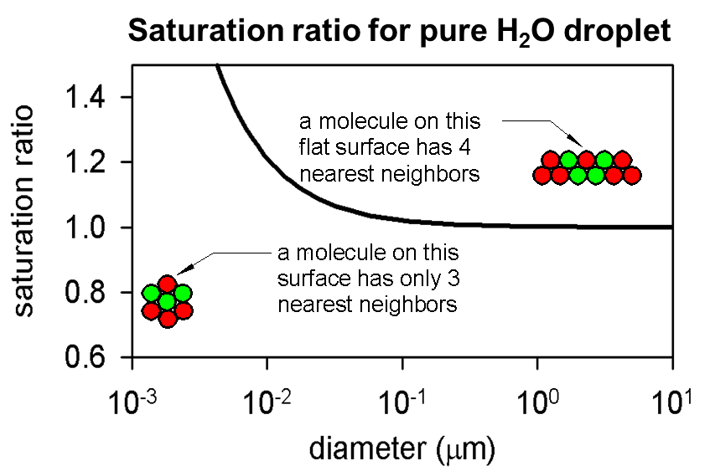
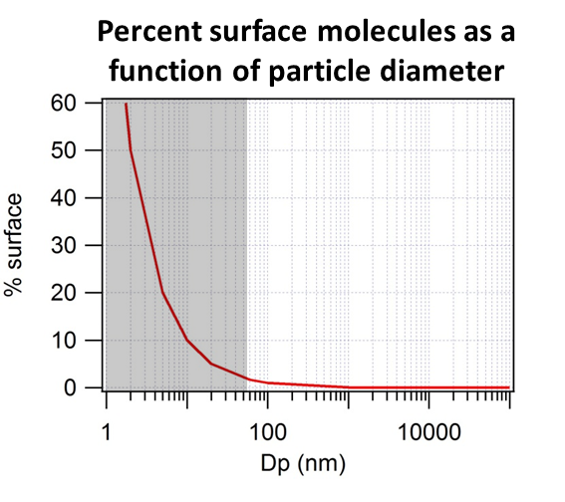
Why should we care about atmospheric nanoparticles?
Nanoparticles are the “building blocks” of atmospheric aerosols … their formation is observed around the world and their growth to larger sizes is important for cloud formation.
Nanoparticles may have health impacts because of their ability to translocate.
Nanoparticles are a unique state of matter that lie in the transition between molecular clusters (~1 nm) and bulk aerosol (>50 nm).

Slide 6
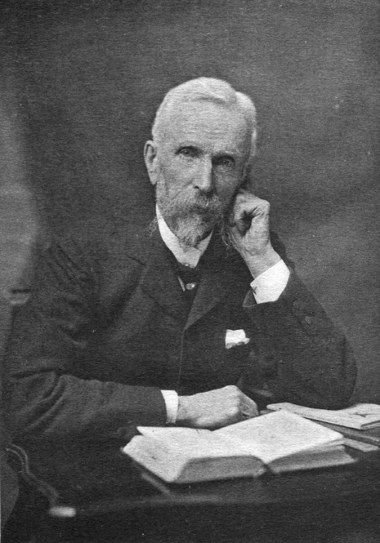
Measuring the chemical composition of atmospheric nanoparticles
The great difficulty in investigations of this kind is the extremely minute quantities of matter which produce surprising results and make the work full of pitfalls for the hasty.
For typical sample flows and times (20 min) we can collect, at most:
13 pg of 5 nm particles
100 pg of 10 nm particles
800 pg of 20 nm particles
John Aitken (1839-1919)
On some nuclei of cloudy condensation, Proc. R.S.E., 1923

Slide 7
Direct measurements of nanoparticle composition: Thermal Desorption Chemical Ionization Mass Spectrometer (TDCIMS)
an instrument for characterizing the molecular composition of
ambient particles from 8 to 50 nm in diameter
unipolar charger
and nano-DMA
high resolution
time-of-flight
mass spectrometer
electrostatic
precipitator
Smith et al., 2004

Slide 8
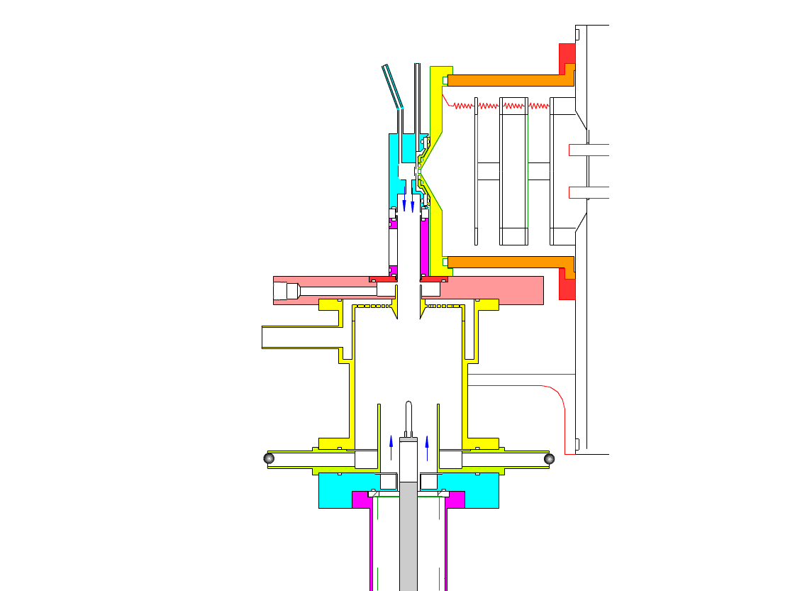
TDCIMS electrostatic precipitator
no voltage applied to filament
de-clustering cell
ion source
mass
spectro-meter.
clean sheath
gas flows
size-selected nanoparticles
collection filament
Smith et al., 2004

Slide 9

TDCIMS electrostatic precipitator
4000 V applied to filament
Charged particles are attracted to the filament by the electric field.
Collection is done at room temperature and pressure for ~30 min in order to collect ~100 pg sample.
Concentration of particles exiting precipitator noted for estimating collected fraction.
Smith et al., 2004

Slide 10

TDCIMS electrostatic precipitator
collection complete
filament moved into ion source
Charged particles are attracted to the filament by the electric field.
Collection is done at room temperature and pressure for ~30 min in order to collect ~100 pg sample.
Concentration of particles exiting precipitator noted for estimating collected fraction.
Smith et al., 2004

Slide 11
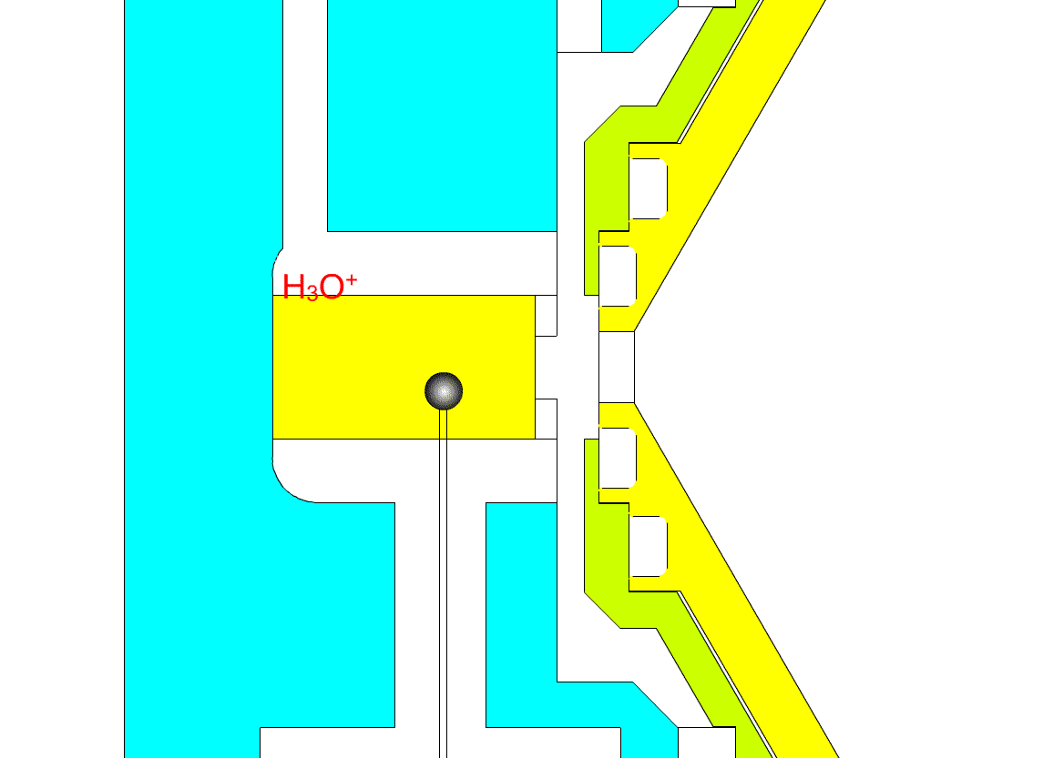
TDCIMS ion source
Close-up of ion source during
sample desorption
Filament temperature ramped to ~550 °C to
desorb sample.
Reagent ions are created by α particles emitted from the radioactive source, generating mostly H₃O⁺ and O₂⁻ (and clusters with water).
Evaporated compounds are ionized using chemical ionization with reagent ions,
e.g.: (H₂O )_{n}H₃O⁺ + NH₃ → (H₂O )_{m}NH₄⁺ + (H₂O)_{n-m}
Ions are injected into a mass spectrometer for analysis
pinhole to vacuum chamber
²⁴¹Am
foil
to mass spec
Pt filament
Smith et al., 2004

Slide 12
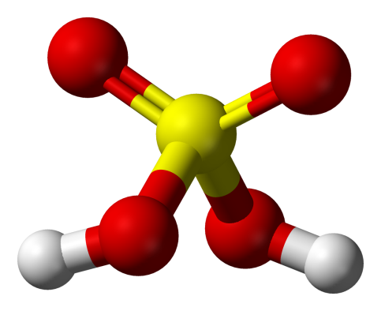
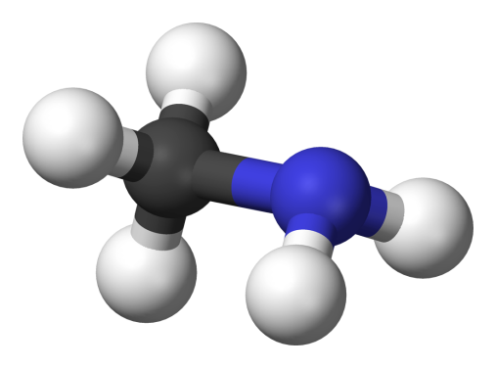
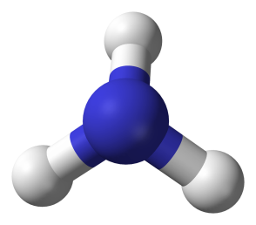
Understanding the role of acid-base chemistry in nanoparticle growth
“the products of combustion of the sulphur in our coals, especially when mixed with the other products of combustion, such as ammonia, … give rise to a very fine-textured dry fog, they are probably one of the chief causes of our town fogs”
ammonia, NH₃
sulfuric acid, H₂SO₄
methylamine, CH₅N
John Aitken (1839-1919)
On dust, fogs, and clouds, Trans. R.S.E., 1880

Slide 13
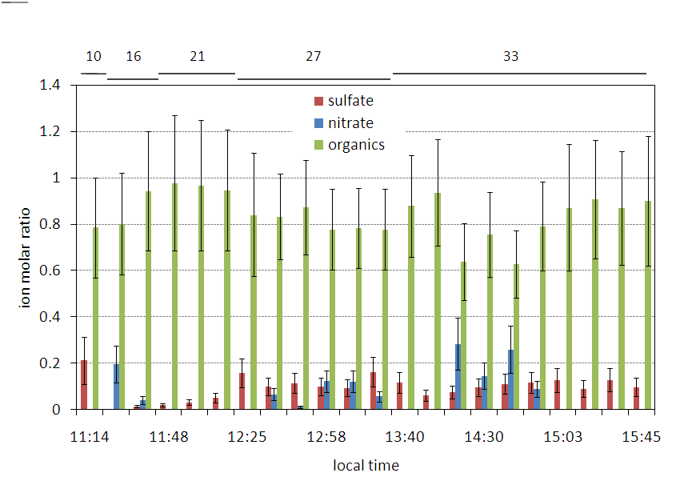
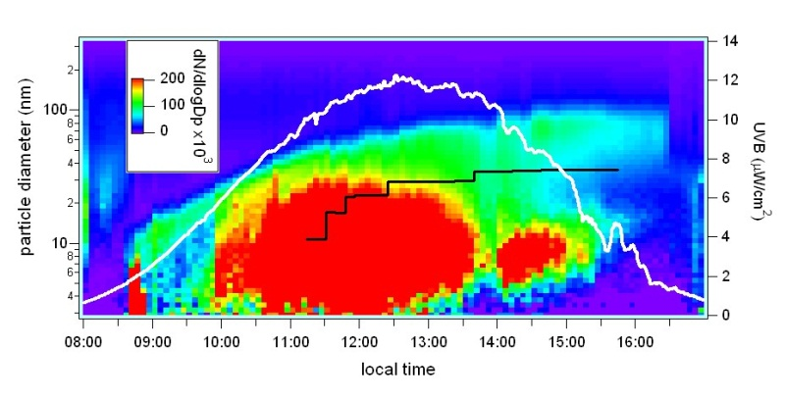
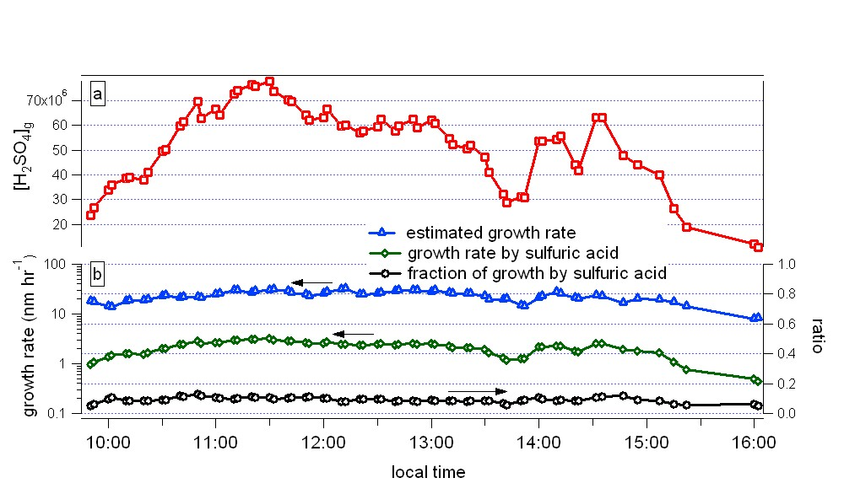
We seem to understand the role of sulfuric acid uptake in nanoparticle growth: Chemical closure achieved for an event in Mexico City
TDCIMS says sulfate accounts for ~10% of detected negative ions
Modeled growth from
measured sulfuric acid shows
that uptake accounts for
~10% of observed growth
Smith et al., GRL, 2008
Notes:
On one day, 16 March, we focused specifically on
13

Slide 14
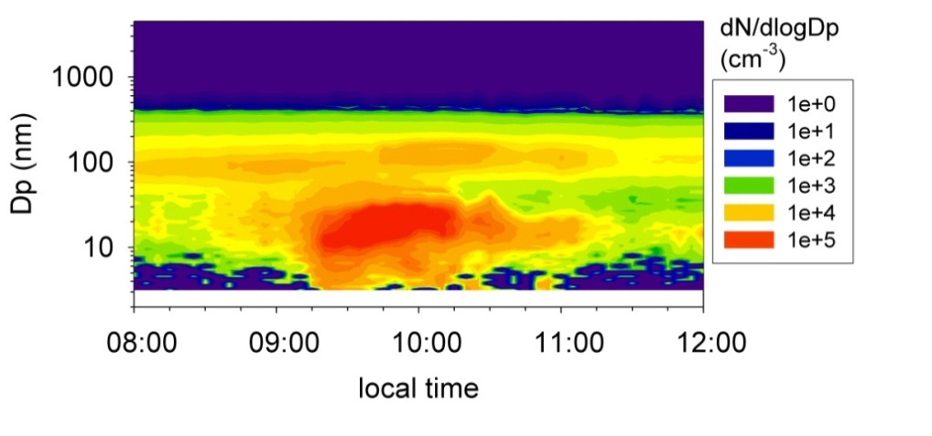
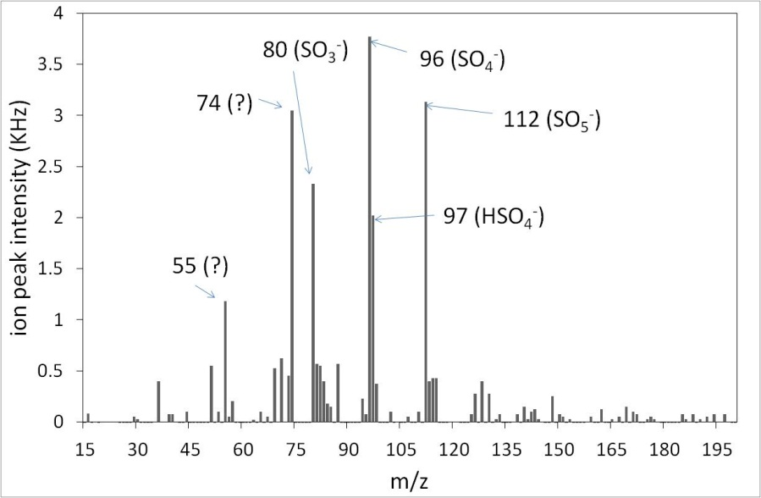
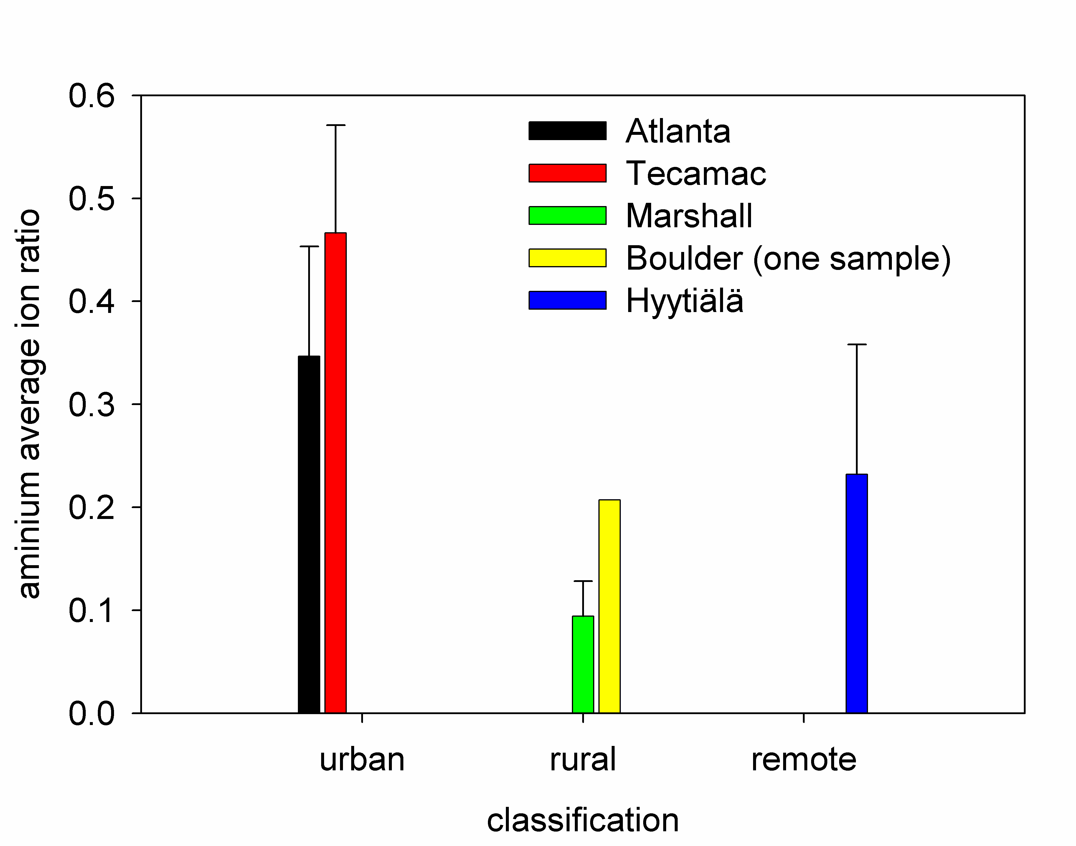
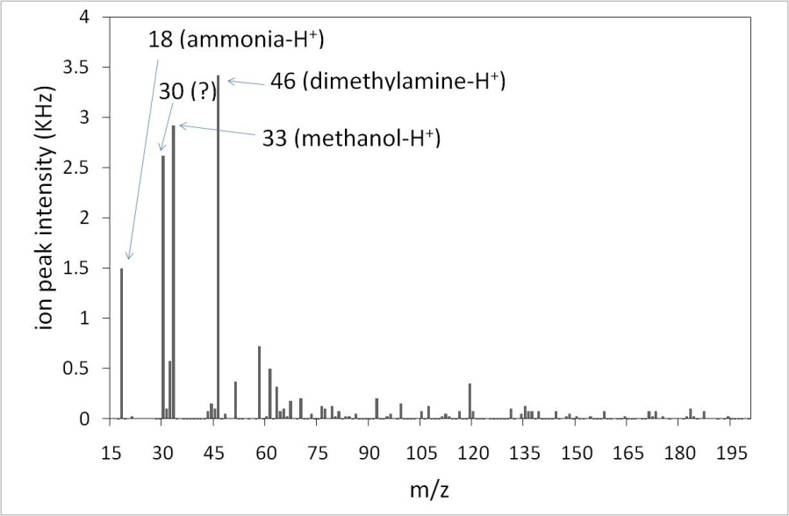
Observations of amines and ammonia suggests that salt formation is an important process in nanoparticle growth
negative ions
organic salt formation can comprise
10-50% of nanoparticle composition
positive ions
Smith et al., PNAS 2011

Slide 15

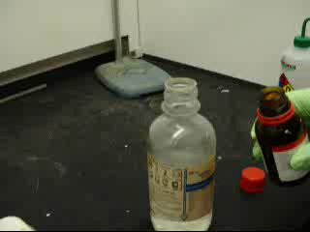
Salt formation makes new particles … a simple demonstration
volatile!
non-volatile!
a base (CH₃NH₂)
an acid (HCl)
Experiment performed by H. Friedli
Notes:
I’m starting this talk with a demonstration of new particle formation from gaseous precursors. Here we have Hans Friedli taking two chemicals, and combining the vapors that exit the top of the bottles. Once he lines up the vapors so they combine, you can see a cloud of particles. This is even better illuminated with the last pointer.

Slide 16
The role of highly-oxidized organics in nanoparticle growth
“It seems therefore probable that the sun’s rays will decompose some of the gases and vapours in the air, and if these decomposed substances have a lower vapour tension than the substance from which they are formed, they condense into very fine particles.”
John Aitken (1839-1919)
On dust, fogs, and clouds, Trans. R.S.E., 1880

Slide 17
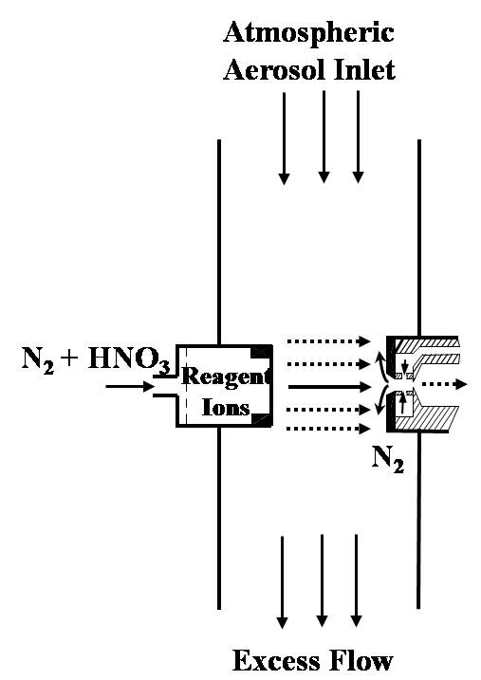
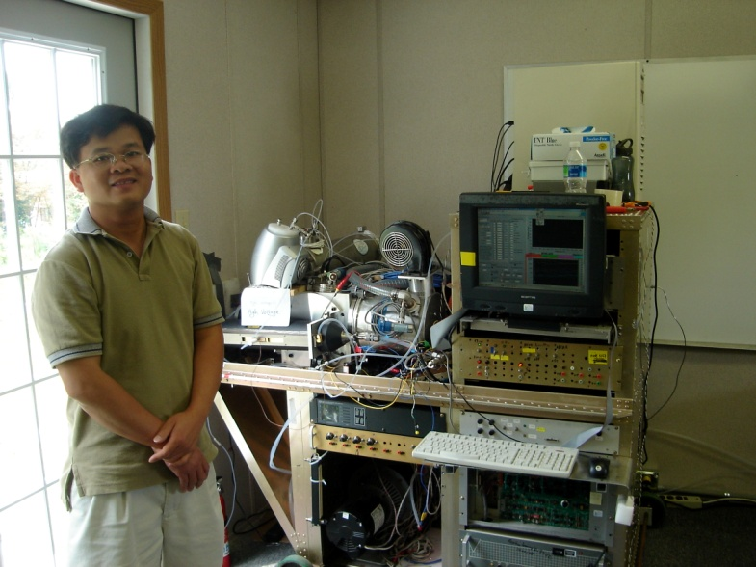
Cluster Chemical Ionization Mass Spectrometer (Cluster CIMS)
Can detect sticky compounds with a “wall-less” inlet
Chemically ionizes ambient gases and clusters using (HNO₃)NO₃⁻ or acetate.
Most organic acids for adducts with NO₃⁻
Analyzes ions with a quadrupole mass spectrometer
mass
spec
Zhao et al., JGR, 2010

Slide 18
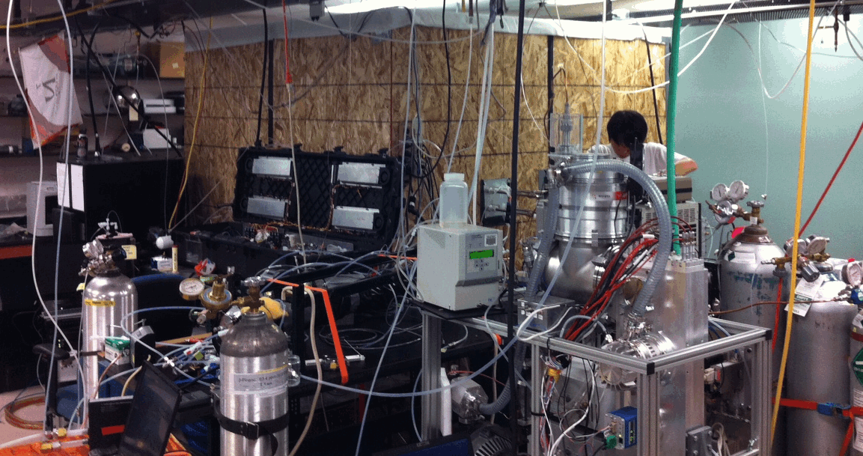
Laboratory studies of nanoparticle growth by organics
6 L temperature-controlled flow tube + 10 m³ Teflon bag reaction chamber
+ biogenic emissions enclosure for sampling VOCs from live plant emissions
Photo: recent laboratory campaign to study new particle formation and growth from
biogenic VOC + nitrate radical chemistry.
VanReken et al., ACP, 2006

Slide 19
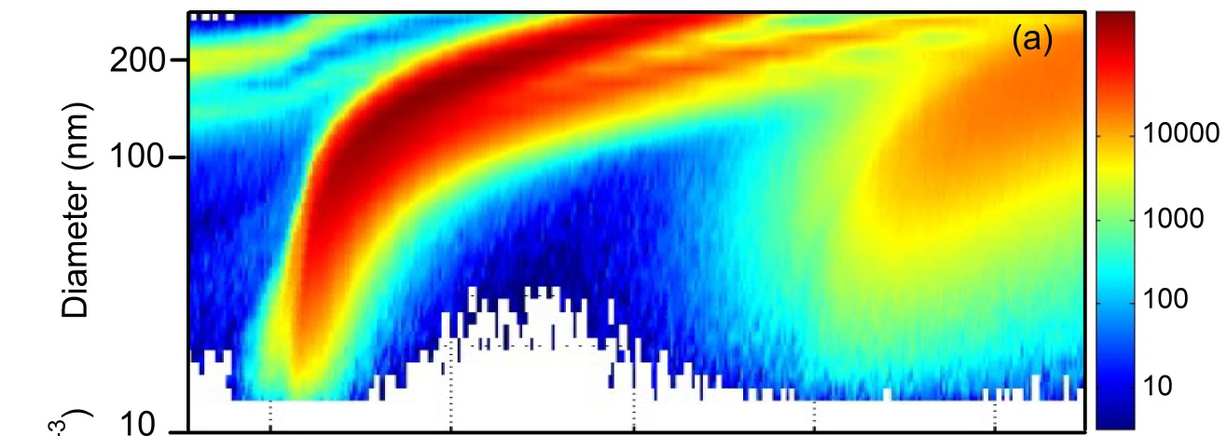
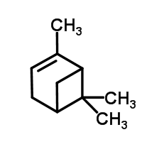


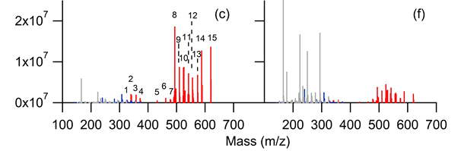
Cluster CIMS: Identifying secondary organic nanoparticle precursors from α-pinene + ozone chamber experiment
α-pinene: 5 ppb
ozone: 50 ppb
NOx ~1 ppb
dN/dlogDp (cm⁻³)
highly oxidized organics
with ~20 Carbons
oxidized organics with
~10 Carbons
Zhao et al., ACP 2013

Slide 20
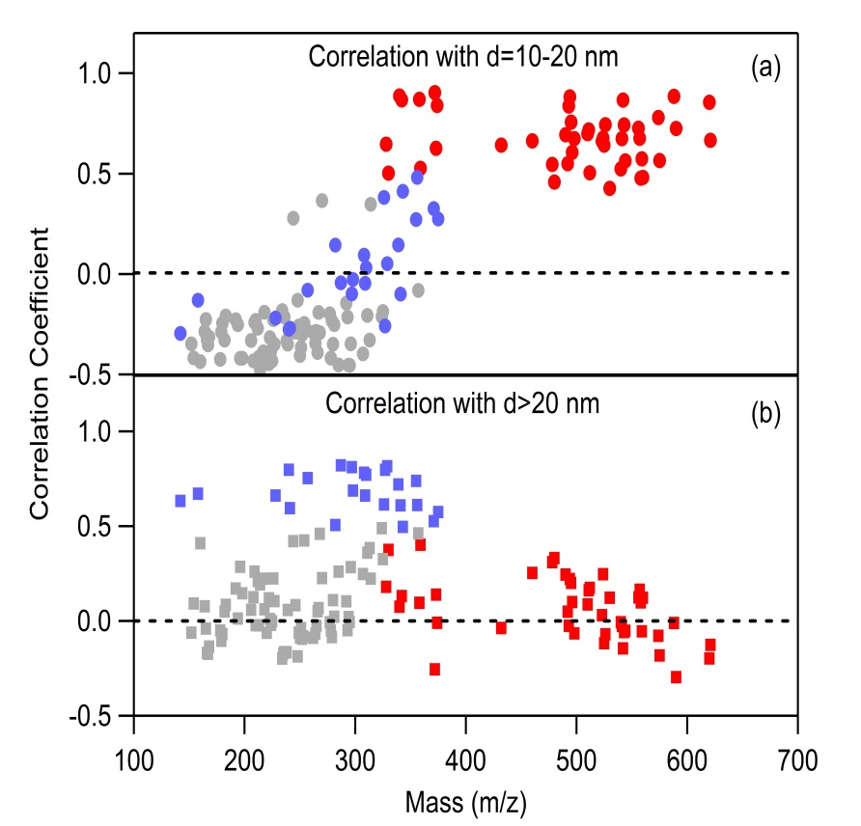
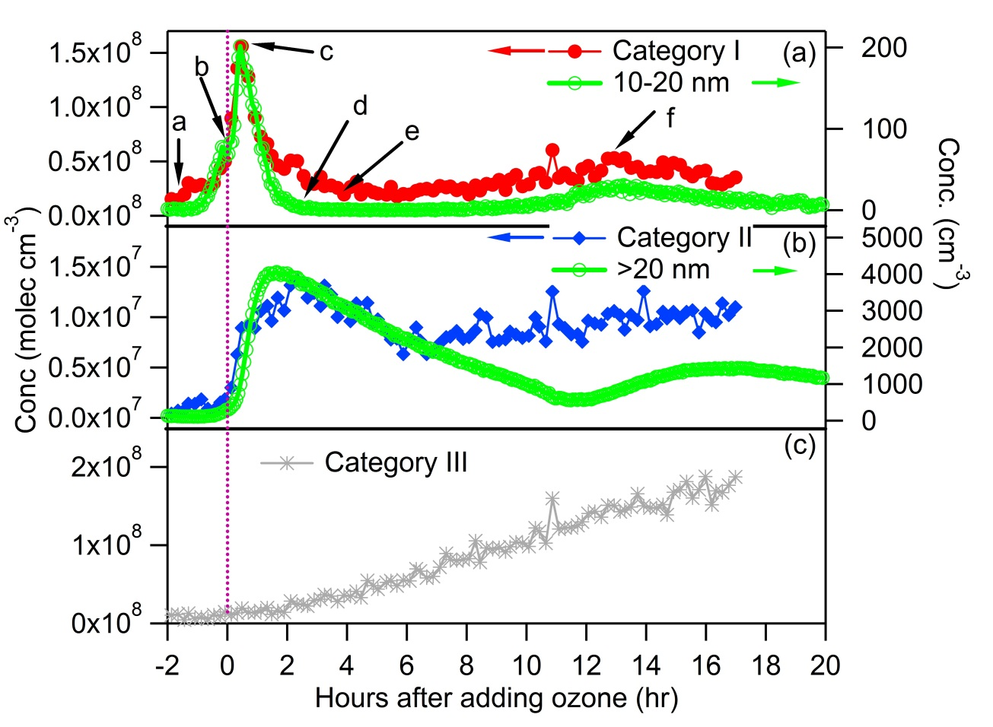
Ozone + α-Pinene: Gas measurements identify compounds that coincide with the formation of 10-20 nm diameter particles
“Category I” compounds correlate with start of particle formation
“Category II” appear to be involved with growth of formed nanoparticles
Zhao et al., ACP 2013

Slide 21

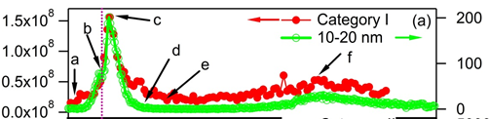
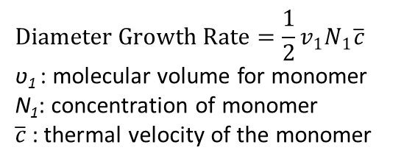
Can condensation of “Category I” compounds explain observed nanoparticle growth rates?
dN/dlogDp (cm⁻³)
observed growth
rate: 36 nm/hr
A really simple chemical closure calculation
$$Diameter Growth Rate=\frac{1}{2}v_{1}N_{1}\overline{c}$$
ʋ₁ : molecular volume for monomer
N₁: concentration of monomer
$\overline{c}$ : thermal velocity of the monomer
36 nm/hr growth rate would require:
N₁(m/z 500) = 3.3 x 10⁸ cm⁻³
N_{1,obs} (Category I) ~1.5 x 10⁸ cm⁻³
Zhao et al., ACP 2013

Slide 22

Condensing oxidized organic compounds make new particles … a simple demonstration
terpenes + O₃
“Category I” species

Slide 23
To summarize, two important processes for nanoparticle growth are …
… the reactive uptake of acids, bases, etc. …
… and the condensation of high molecular
weight, highly oxidized organics
acid (HCl) + base (CH₃NH₂)
salt (CH₃NH₃⁺Cl⁻)
terpenes + O₃
“Category I” species

