Slide 1
B
R
A
C
E
enefits of
educing
nthropogenic
limate
chang
When can we expect to see the benefits of climate mitigation?
Ben Sanderson ⦿ Claudia Tebaldi ⦿ Brian O’Neill ⦿ Kieth Oleson

Slide 2
Contents
Does initial condition variability matter? How many ensemble members do we need to sample it?
When is scenario uncertainty detectable in the presence of initial condition uncertainty?
Do we need to run more than one initial condition ensemble, or do we just need to know the mean and variance?

Slide 3
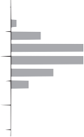
Noise matters…
6
United States
6
4
4
2
Temperature Anomaly (K)
2
0
Temperature Trend (K/55 years)
-2
0
-2
Year
adapted from Deser et al (2012)

Slide 4
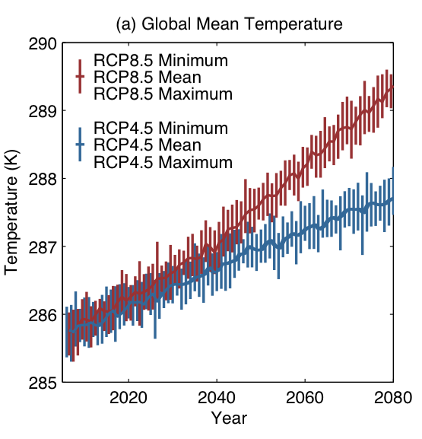

Slide 5
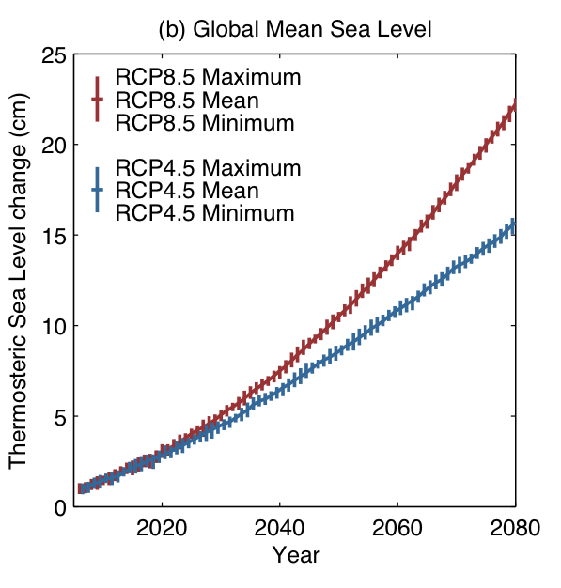
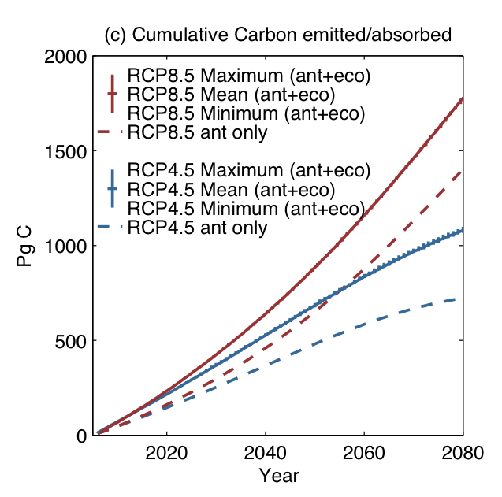

Slide 6
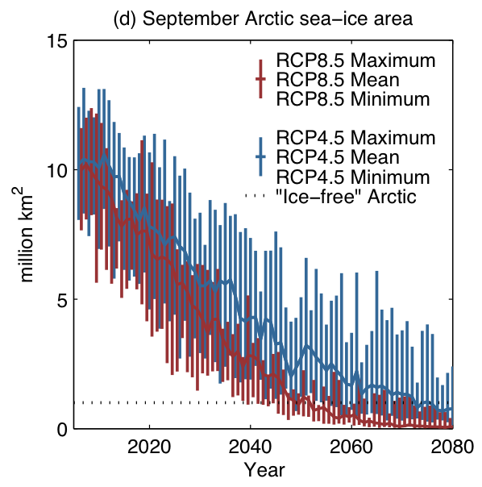

Slide 7
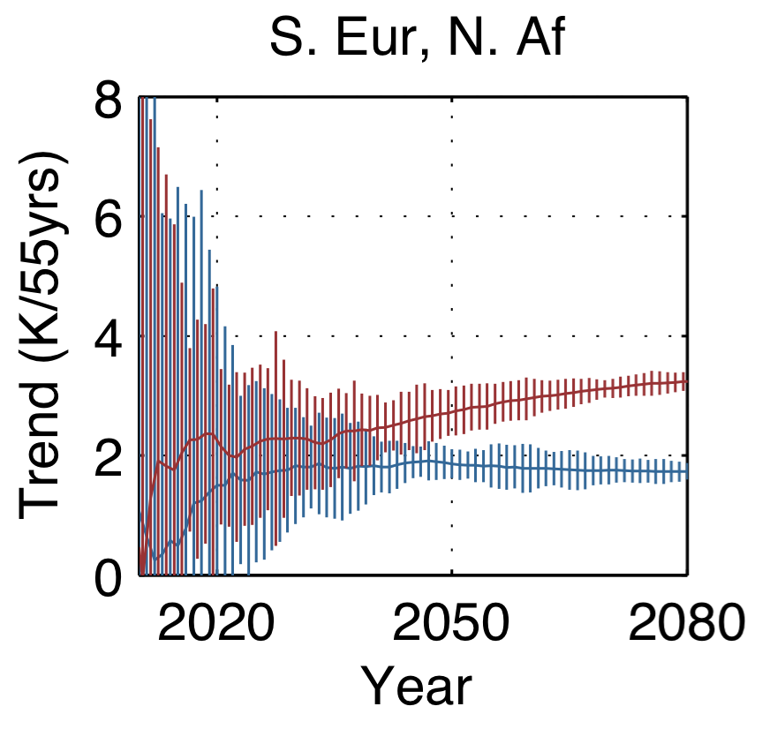
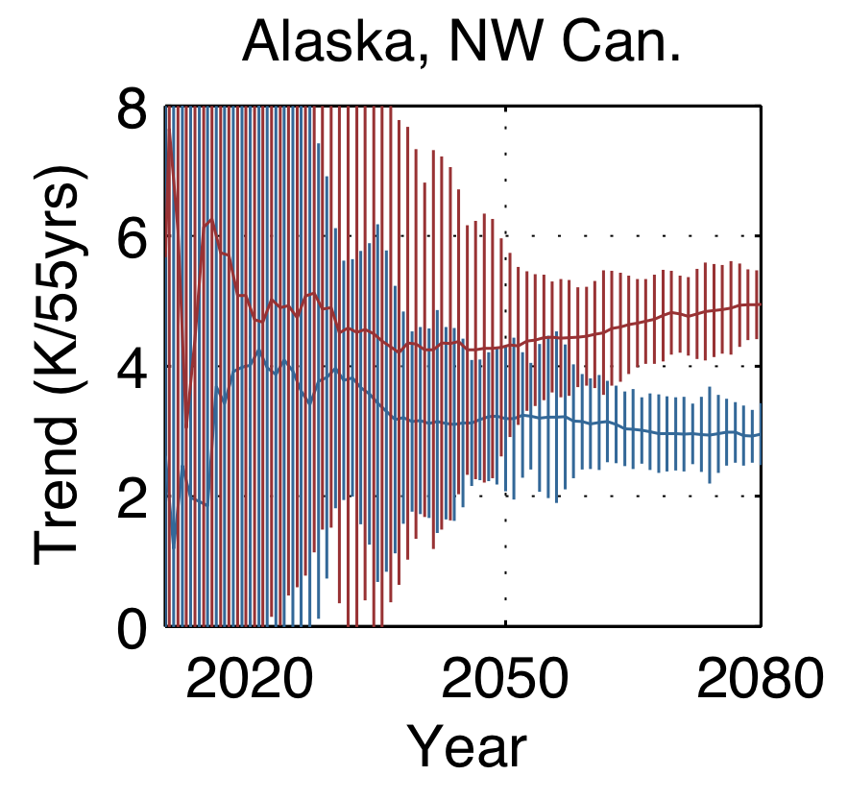

Slide 8
But, do we need large ensembles?

Slide 9
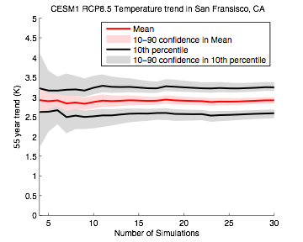
Trends are easy enough
San Fransisco, CA
Temperature change per 55 years (K)
Number of Simulations

Slide 10
Not significant
RCP 8.5 - RCP4.5 (2060-2080) DJF Temperature

Slide 11
A word of caution…
Difference in maximum temperature relative to Decadal Average
3
0
-3
(K)
RCP8.5-RCP4.5 (2060-2080)

Slide 12
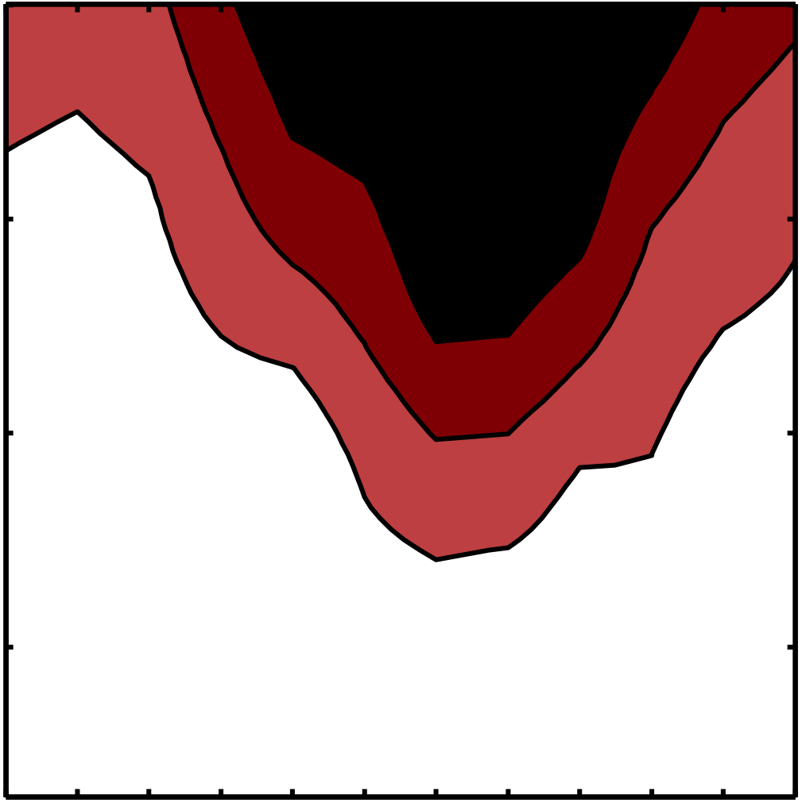
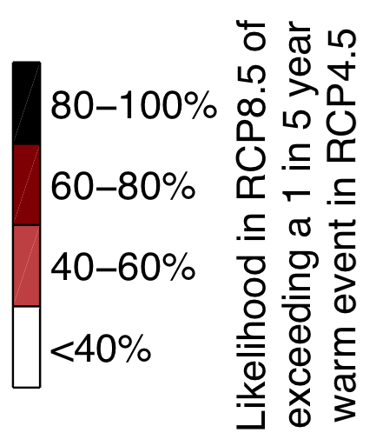
2080
2060
Year
2040
2020
Western United States
Jan
Feb
Mar
Apr
May
Jun
Jul
Aug
Sep
Oct
Nov
Dec
Month

Slide 13
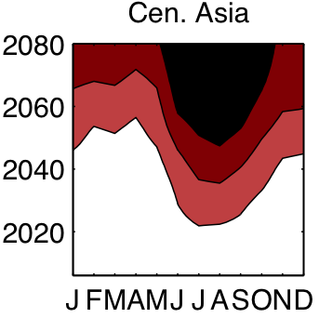
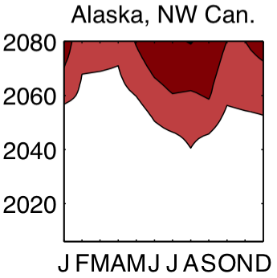
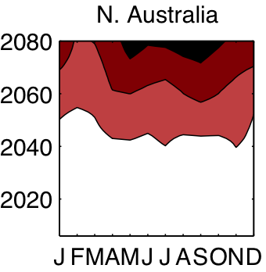
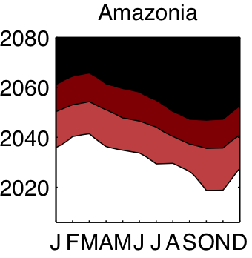
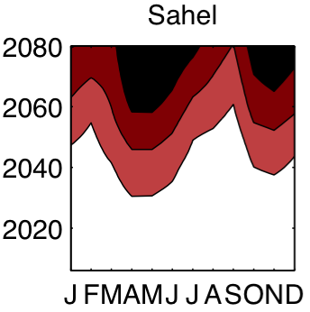

Slide 14
OK, so do we need multiple large ensembles?

Slide 15
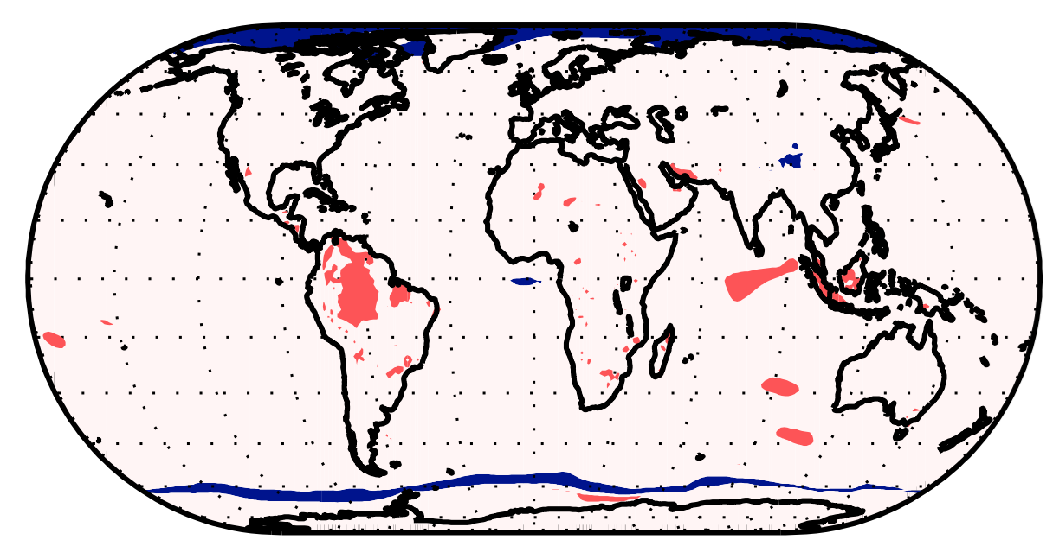
Ratio of RCP8.5:RCP4.5 ensemble Surface Temperature variances (SON)

Slide 16
Not significant
RCP 8.5 - RCP4.5 (2060-2080) JJA Precipitation

Slide 17
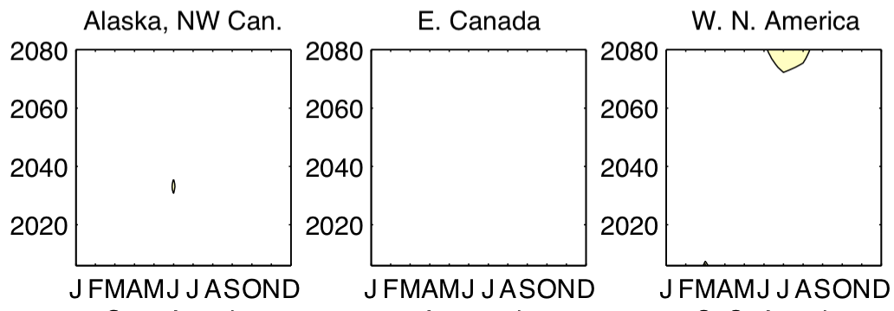
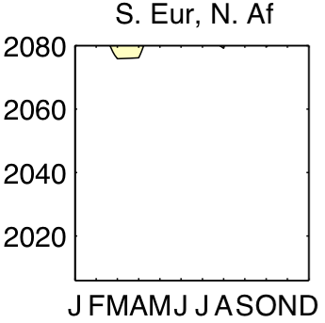
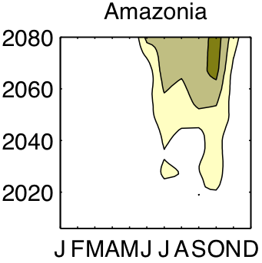
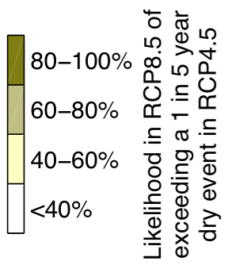

Slide 18
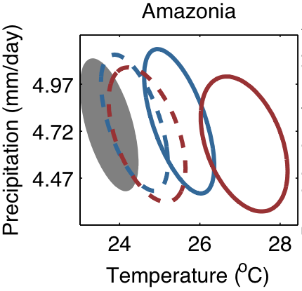
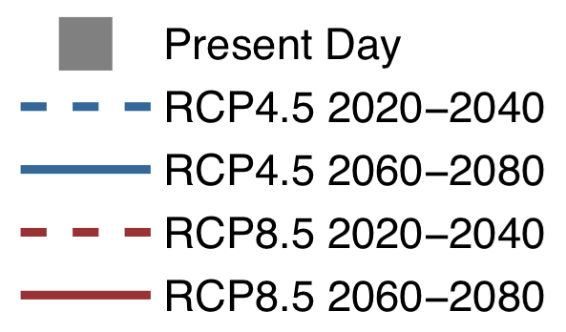

Slide 19
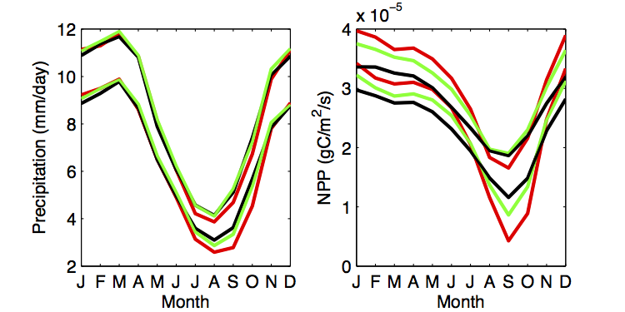
RCP8.5 5-95% ensemble range (2060-2080)
RCP8.5: a more intense dry season
with dying trees
RCP4.5 5-95% ensemble range (2060-2080)
Historical 5-95% ensemble range (1985-2005)

Slide 20
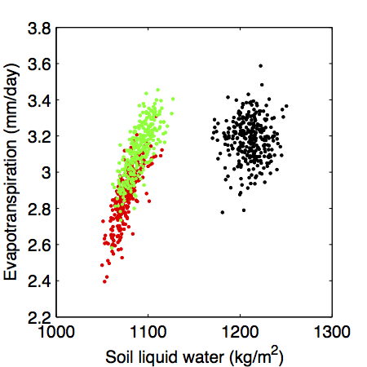
A shift in regime...
RCP8.5 (2060-2080)
RCP4.5 (2060-2080)
Historical (1985-2005)

Slide 21
Conclusions
Modeled mean temperatures are universally and significantly warmer in RCP8.5 than RCP4.5 by 2060
Differences in the risk of extreme warm events are evident as early as 2020
Precipitation differences are less significant, with the exception of some specific regions.

Slide 22
Not significant
RCP 8.5 - RCP4.5 (2060-2080) JJA Precipitation

Slide 23
