Slide 1
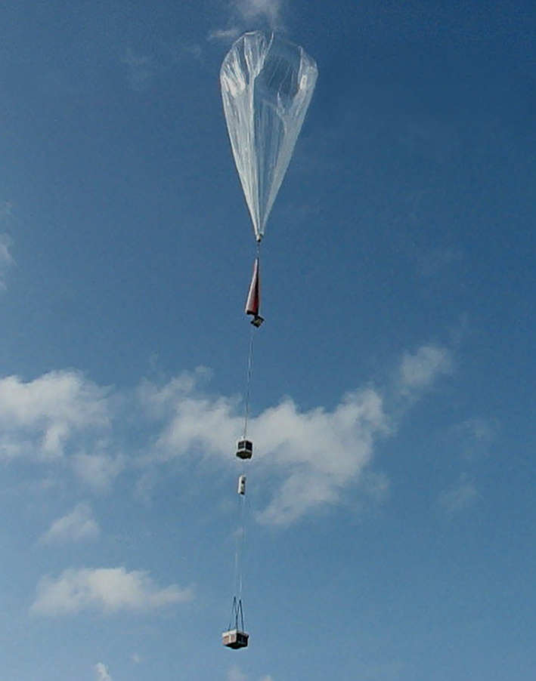
Exploration of the tropical tropopause region during Strateole-2
Holger Vömel
NCAR Science Day 17 April 2015

Slide 2
Overview
What is Strateole
Motivation
Science questions
Instrumentation
Campaign plans
Expected outcome

Slide 3
What is Strateole
Strateole: Long duration balloon program by the French Space Agency (CNES: Centre National d'Études Spatiales)
Superpressure balloon duration up to 3 months
Balloon altitudes ≈ 20 km (55 hPa) and 18.5 km (70 hPa)
Previous campaigns in cooperation with NSF / NCAR in Africa (2006), Pacific (2008), and Antarctica (Concordiasi: 2010)

Slide 4
What is Strateole-2
Strateole-2 focuses on tropics in particular tropical tropopause layer
Validation flights planned 2017/2018
Main campaigns planned for 2018/2019 season and launch site TBD
Two campaigns scheduled about one year apart

Slide 5
Zonal mean picture
From Randel and Jensen 2013
Notes:
Wave activity
Ventilation of the TTL sideways and upwards.
Synoptic-scale Rossby waves that break in the subtropical jets create a mean poleward drift and drive the vertical motion in the TTL (shallow-branch of the Brewer-Dobson circulation)
Solid contours denote mean zonal winds
Arrows denote propagation of waves

Slide 6
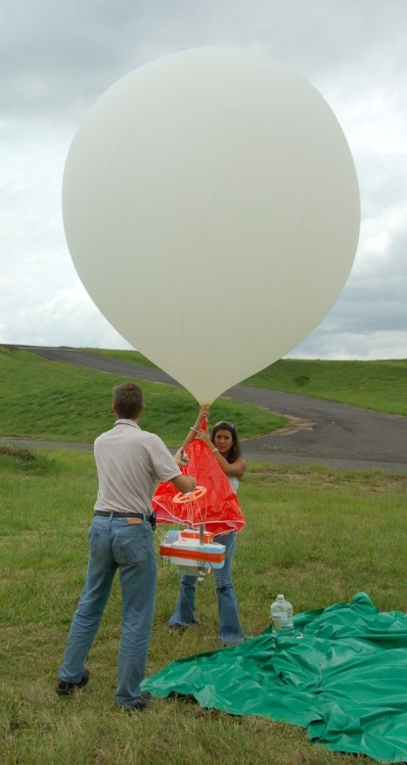
Water Vapor Climatology: Costa Rica
Regular water vapor and ozone soundings at San Jose since 2005

Slide 7
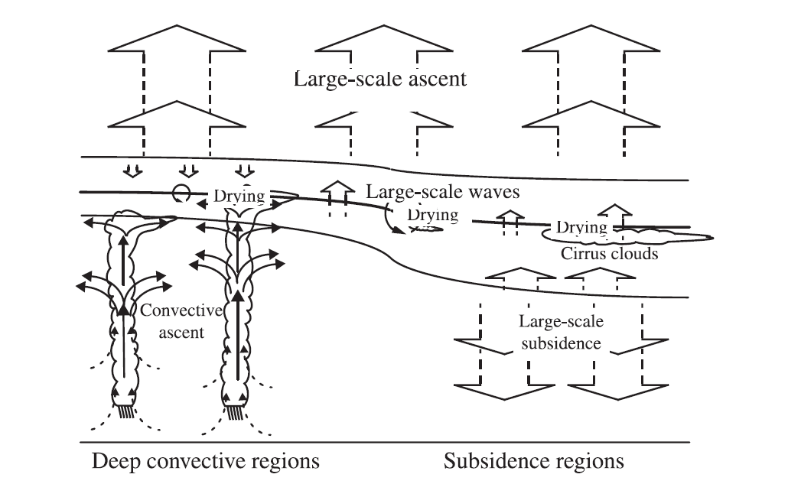
Different regions in the tropics
Top of tropopause layer
Tropopause
Level of mean convective outflow
From Vömel et al., 2002
Notes:
Challenge:
Identify and quantify regions, that contribute to dehydration
Quantify the importance of the different dehydration processes:
Convective dehydration
Slow scale dehydration
Wave driven dehydration
Superstaturation in clouds
Increase the reliability in water vapor observations
Increase the number of observations
Validate global scale systems
Provide continuity to these observations

Slide 8
Different regions in the tropics
Strateole-2 region
Top of tropopause layer
Tropopause
Level of mean convective outflow
From Vömel et al., 2002
Notes:
Challenge:
Identify and quantify regions, that contribute to dehydration
Quantify the importance of the different dehydration processes:
Convective dehydration
Slow scale dehydration
Wave driven dehydration
Superstaturation in clouds
Increase the reliability in water vapor observations
Increase the number of observations
Validate global scale systems
Provide continuity to these observations

Slide 9
Science issues
Wave driving of the QBO
Gravity-wave generation by deep convection
Wave transition to turbulence and vertical mixing
Interactions between gravity/planetary waves and microphysics
Improvement of model parameterizations of wave activity
Validation of (re-)analyses winds and temperature in the TTL and tropical lower stratosphere
Validation of satellite observed winds (ADM-Aeolus)
…
Notes:
Wave driving of the QBO
+ Relative contribution of each kind of waves (equatorial planetary waves, equatorial inertia gravity waves, short-scale waves)
+ Geographical asymmetries in wave activity
Gravity-wave generation by deep convection
+ Linking gravity waves to local convective sources along the trajectories
Interactions between gravity/planetary waves and microphysics
+ What is the importance of wave-induced temperature disturbances in the formation of cirrus clouds: occurrence, ice crystal number, supersaturation
Wave transition to turbulence and vertical mixing
+ Global role of vertical mixing in TTL transport and temperature

Slide 10
Campaign plan
Lower altitude in situ flights: 70 hPa, 18.5 km
4 times: Meteorology, particle, ozone, water vapor (TTL1)
4 times: Meteorology, particle, tracer, water vapor (TTL2)
Higher altitude profiling flights: 50 hPa, 20 km
4 times: Meteorology, Lidar, fiber optic, GPS ROC (Strat-1)
12 times: Meteorology, driftsondes (Strat-2)
Second campaign roughly one year later
Notes:
Scientific payload weight up to 24 kg including power.

Slide 11
In situ Instruments
Meteorology: GPS position and horizontal wind (CNES) Pressure and Temperature (LMD)
Water Vapor: Tunable diode laser hygrometer (GSMA) Frost point hygrometer (LMD)
Ozone: UV Ozone photometer (LMD and LASP)
Particle counters: WPC (U. Wyoming) LOAC (LPC2E)
Carbon dioxide/Methane: Tunable diode laser (GSMA)
Radiative fluxes: Upward infrared and visible fluxes (LATMOS)
Notes:
GSMA : (Groupe de Spectrométrie Moléculaire et Atmosphérique, Université de Reims
LPC2E-CNRS: Laboratoire de Physique et Chimie de l'Environnement et de l'Espace Université d’Orléans

Slide 12
Profiling Instruments
Driftsonde: T, wind, P, humidity from balloon altitude to ground (NCAR)
Fiber Optic: Continuous temperature profile measurements within a few kilometers below the balloon (LASP)
GPS Radio-Occultation: Temperature and humidity profiles from balloon altitude to ground (Scripps)
Lidar: Downward looking backscatter profiles at 532 nm (CNR)
Notes:
GSMA : (Groupe de Spectrométrie Moléculaire et Atmosphérique, Université de Reims
LPC2E-CNRS: Laboratoire de Physique et Chimie de l'Environnement et de l'Espace Université d’Orléans

Slide 13
Driftsonde
Large zero-pressure or
super-pressure balloon
aloft for days to months
Iridium Satellite
Driftsonde Gondola
→54 dropsondes
Float altitude ~20 km
Dropsonde :
Pressure
Temperature
Relative humidity
Wind
Sondes dropped on command or a pre-programmed schedule
Ground station
(web based
remote operation)

Slide 14
Pre-Concordiasi Feb – May 2010
3 balloons, 3 months duration each
Launched at Seychelles: February 2010
1 in situ payload (circumnavigated the globe)
2 NCAR driftsonde payloads

Slide 15
Pre-Concordiasi Feb – May 2010
Launch at Seychelles: 8, 19 and 21 February 2010
3 balloons, 3 months each
Courtesy of CNES

Slide 16
Pre-Concordiasi Feb – May 2010
Dropsondes Atlantic crossing:
Notes:
19 soundings across the Atlantic on the driftsonde, which was pulled out of the equatorial belt. The Atlantic crossing took 10 days, which means we have about twice daily soundings across this region.

Slide 17
Dropsondes Atlantic crossing:

Slide 18
Dropsondes Atlantic crossing:

Slide 19
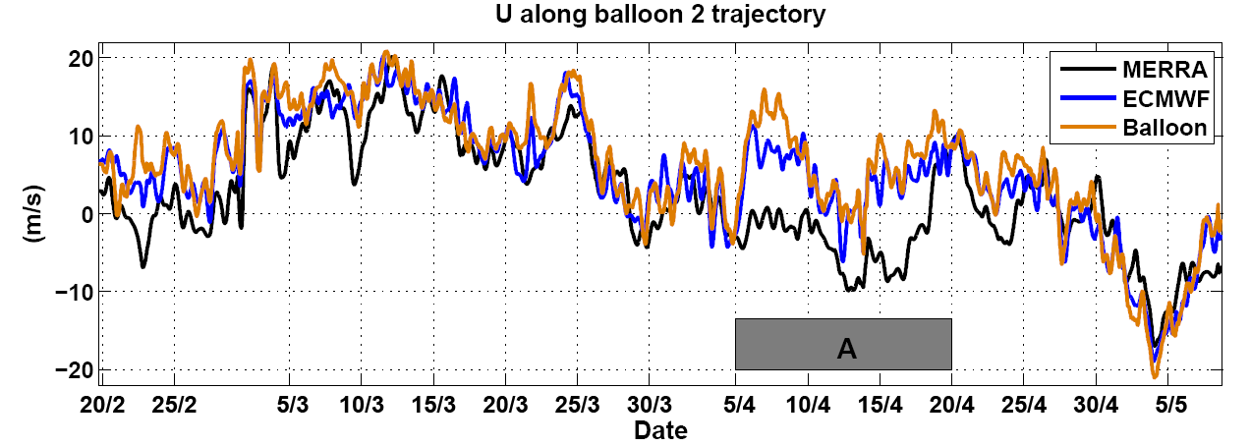
Comparisons of measured and analyzed winds
Podglajen, A., et al., J. Geophys. Res. Atmos., 119, 11,166–11,188
Notes:
Work by Aurélien Podglajen et al.

Slide 20
Comparisons of measured and analyzed winds
Large, long-lasting errors in the equatorial dynamics in current NWP products
Mostly due to poorly simulated equatorial waves
Main cause of error is the lack of wind observations
Podglajen, A., et al., J. Geophys. Res. Atmos., 119, 11,166–11,188

Slide 21
Summary
Strateole-2 focuses on tropical tropopause layer
Validation flights planned 2017/2018
Two campaigns scheduled about one year apart 2018/2019
Expect about 22-24 balloons per campaign, each lasting about 3 months
Expect about 600 dropsonde profiles per campaign
Expect to study the details of atmospheric waves in the transport into the lower stratosphere
Expect to study connection with microphysical processes in the TTL
Comments and feedback welcome

Slide 23
Pre-Concordiasi Feb – May 2010
Dropsondes Western Indian Ocean:
Notes:
41 soundings over 37 days from two different driftsonde balloons in the Western Indian Ocean.
It took both payloads about three weeks to reach the African coast.

Slide 24
Dropsondes Western Indian Ocean:

Slide 25
Dropsondes Western Indian Ocean:

Slide 26
Pre-Concordiasi Feb – May 2010

Slide 27
Pre-Concordiasi Feb – May 2010

Slide 28
Brewer Dobson Circulation
From Holton et al., Rev. Geophys. 1995

Slide 29
Walker circulation
Adapted from Webster (1983)

Slide 30
Brewer Dobson Circulation
From Brewer, QJRMS, 1949

Slide 31
Pre-Concordiasi Feb – May 2010
NCAR
Driftsonde
Payload

